Slide 1
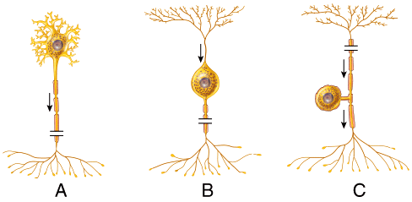
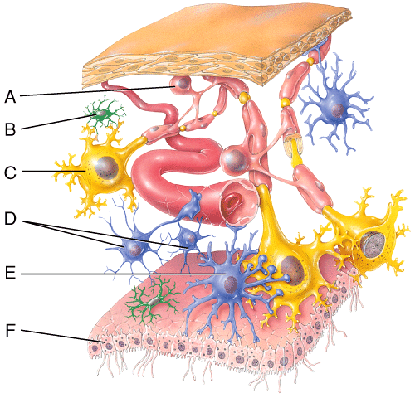
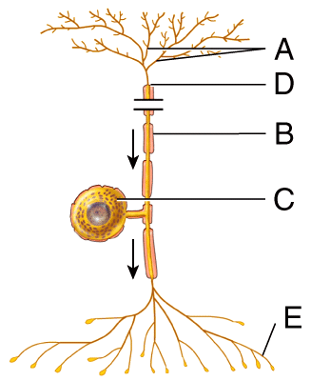
Image

Slide 2
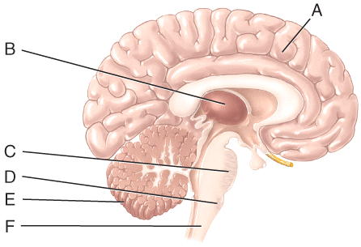
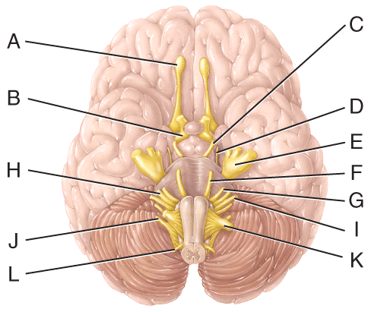

Slide 3
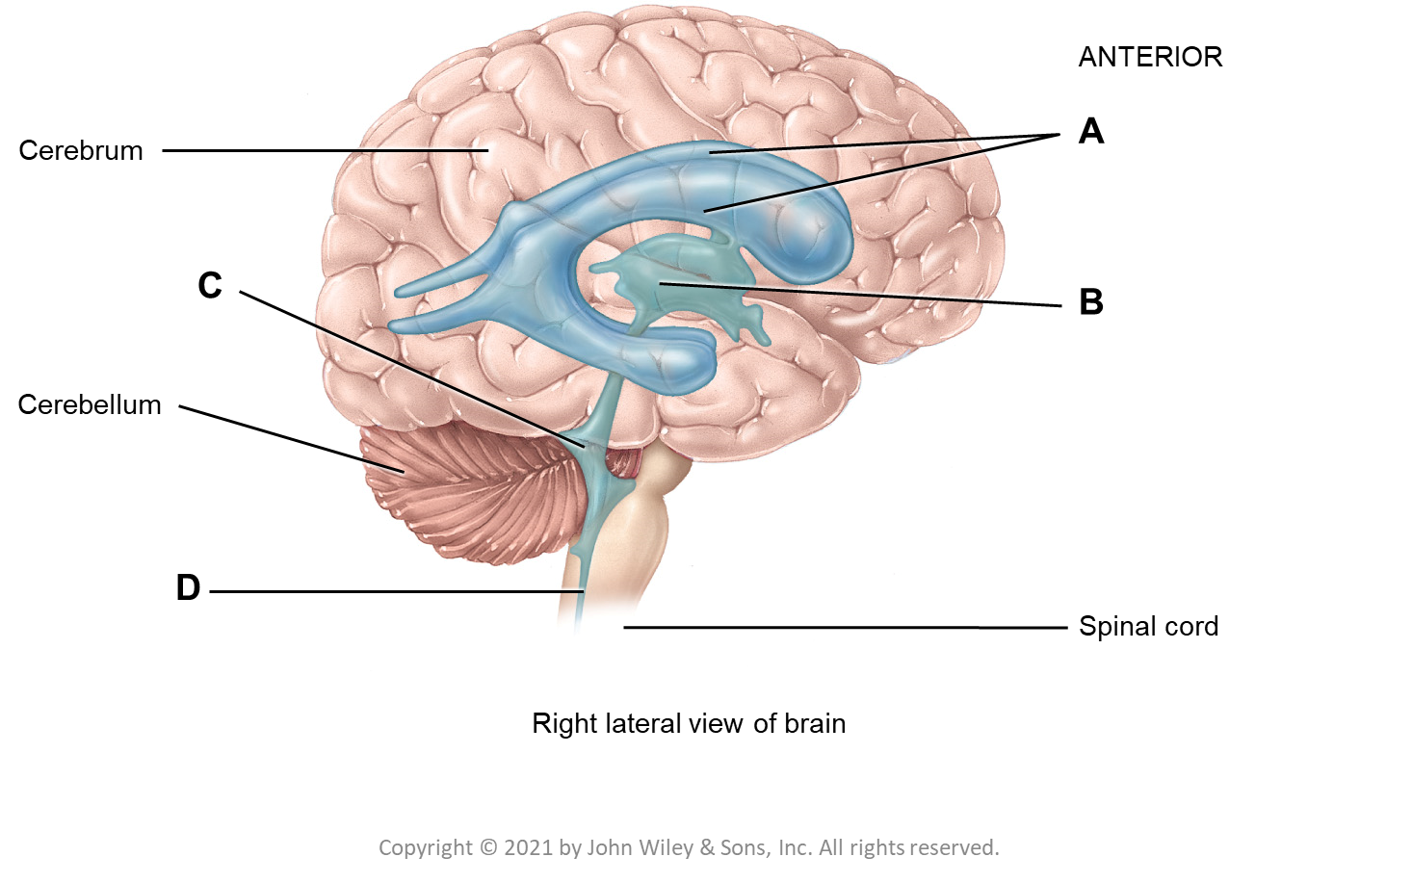
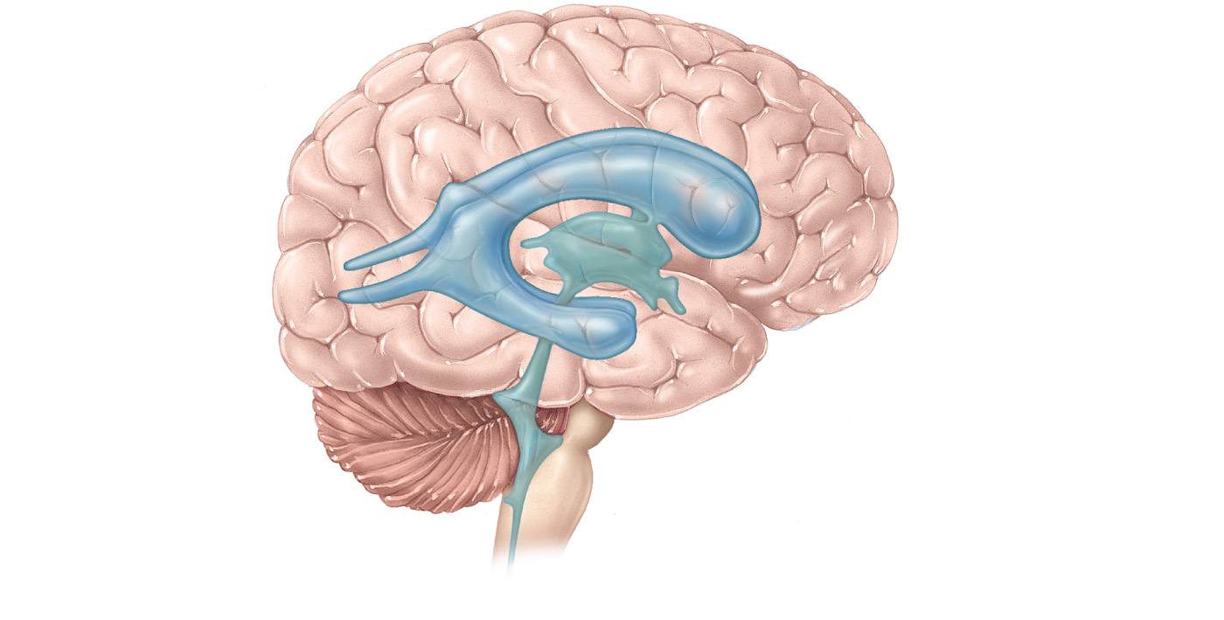
ANTERIOR
A
Cerebrum
C
B
Cerebellum
D
Spinal cord
Right lateral view of brain

Slide 4
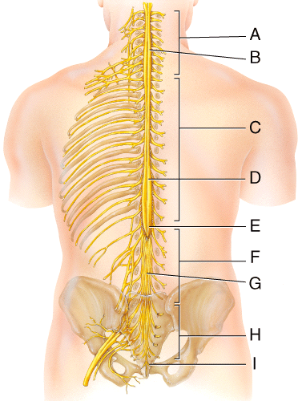
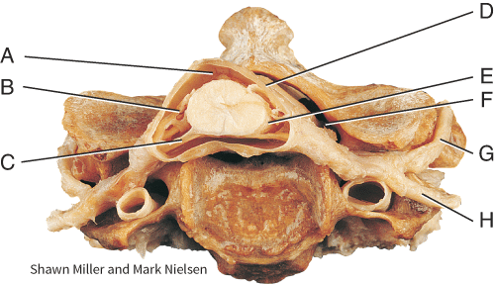
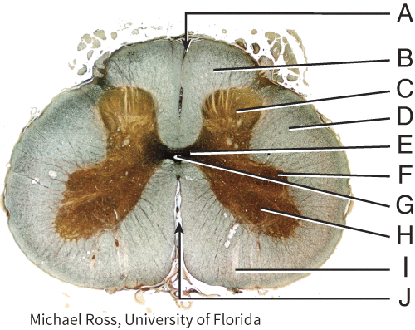

Slide 5
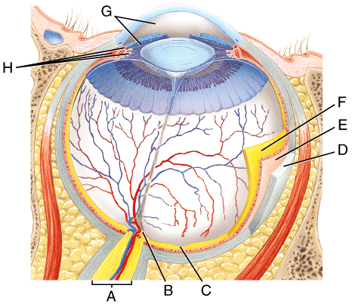
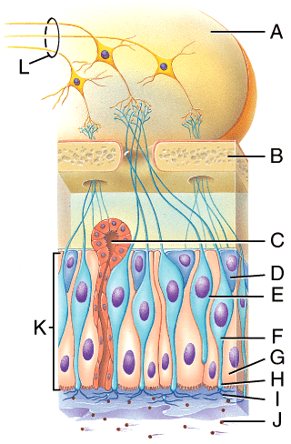
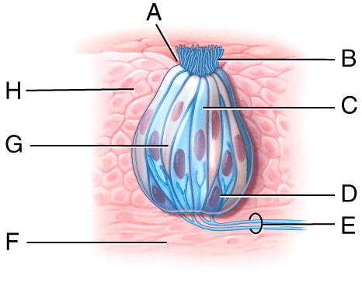

Slide 6
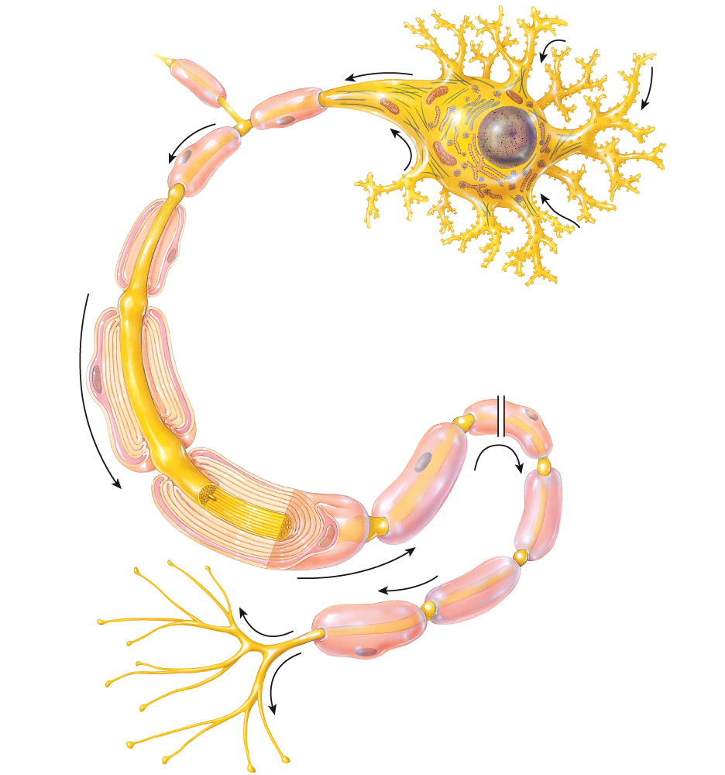
(branches)
(small bumps)
Axon collateral
Axon hillock
Axon
Nucleus
Nucleus of Schwann cell
Schwann cell:
Cytoplasm
Nerve impulse
Myelin sheath
Neurolemma
Myelin sheath gap
Neurofibril
Axon:
Axoplasm
Axolemma
Axon terminal
Synaptic end bulb
(a) Parts of a neuron

Slide 7
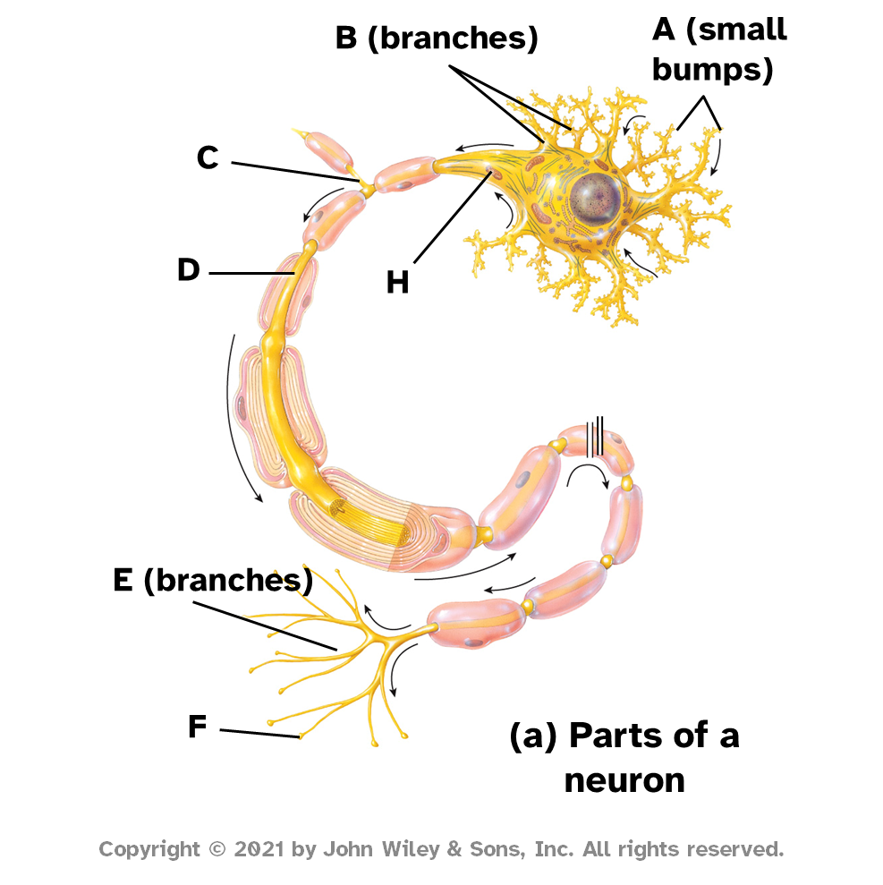
B (branches)
A (small bumps)
C
D
H
E (branches)
F
(a) Parts of a neuron

Slide 8
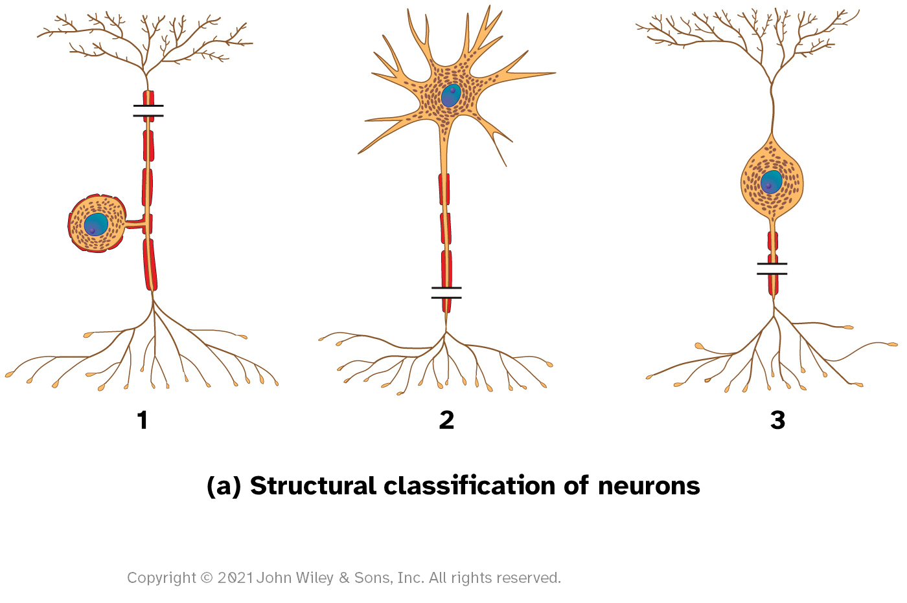
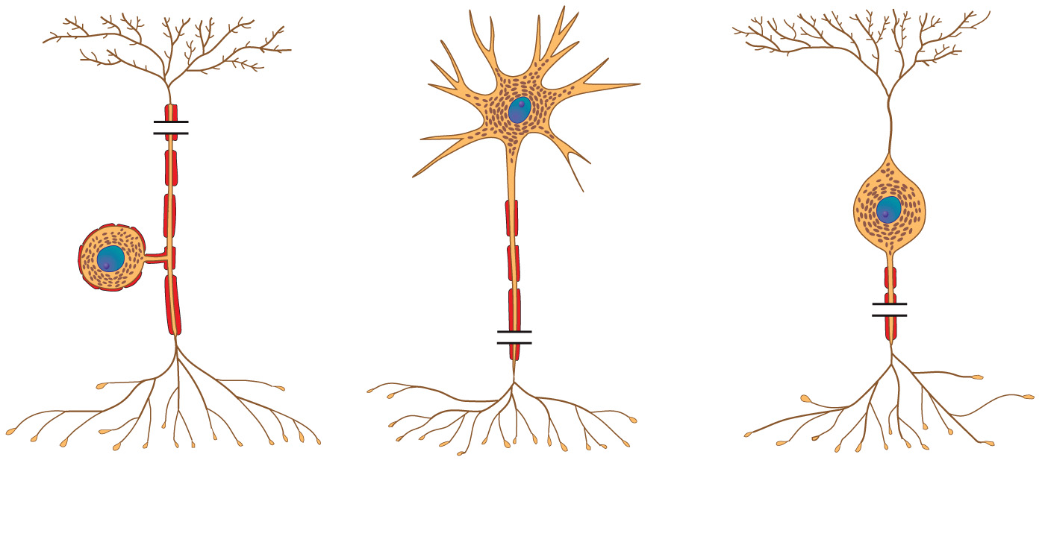
1
2
3
(a) Structural classification of neurons
Copyright © 2021 John Wiley & Sons, Inc. All rights reserved.

Slide 9
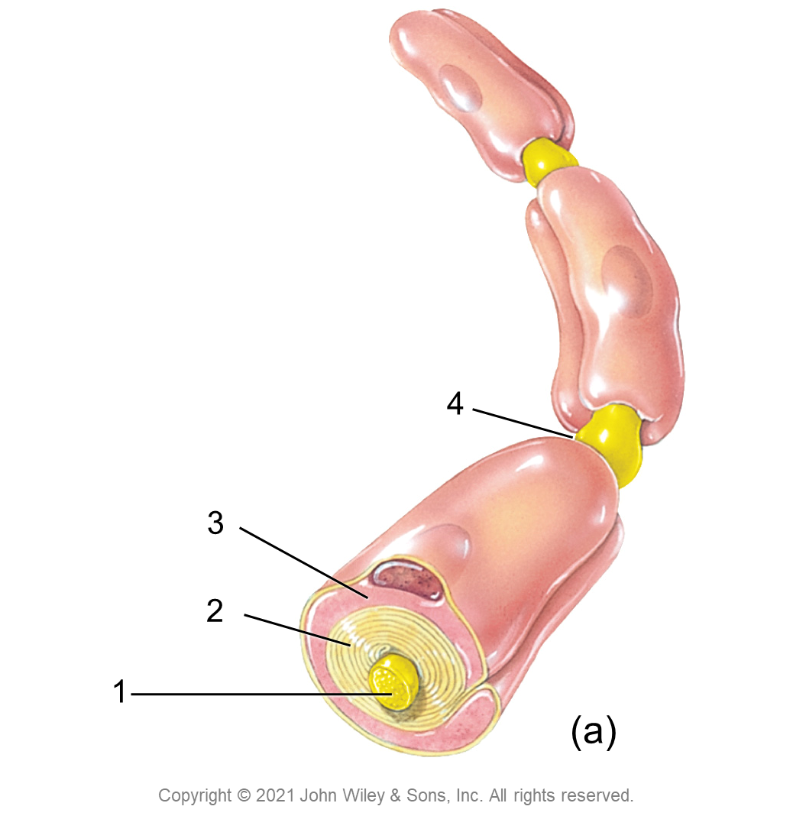

Slide 10
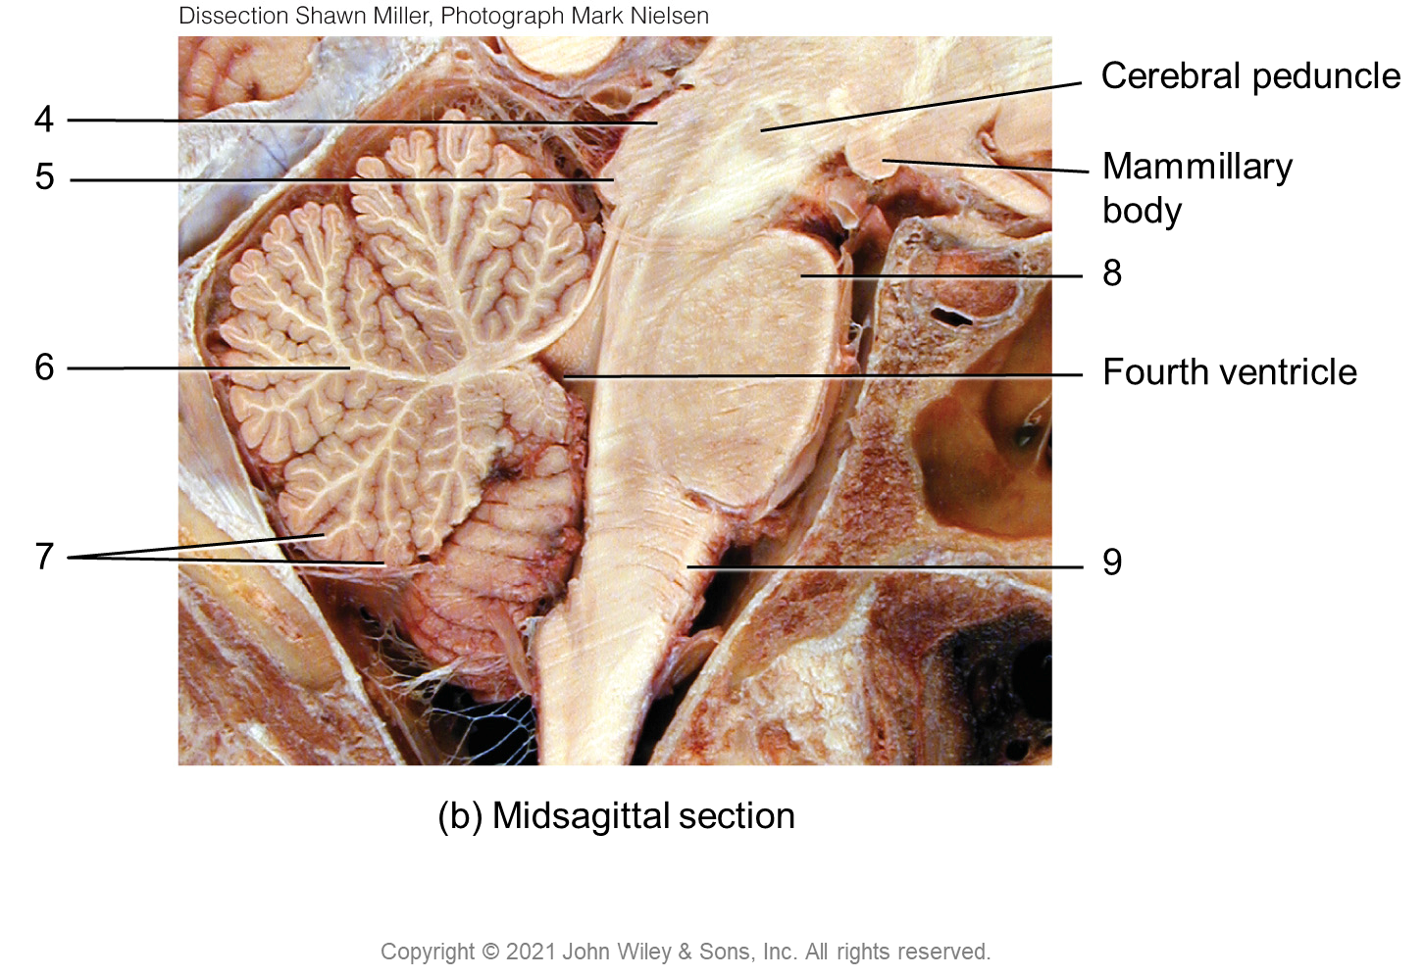
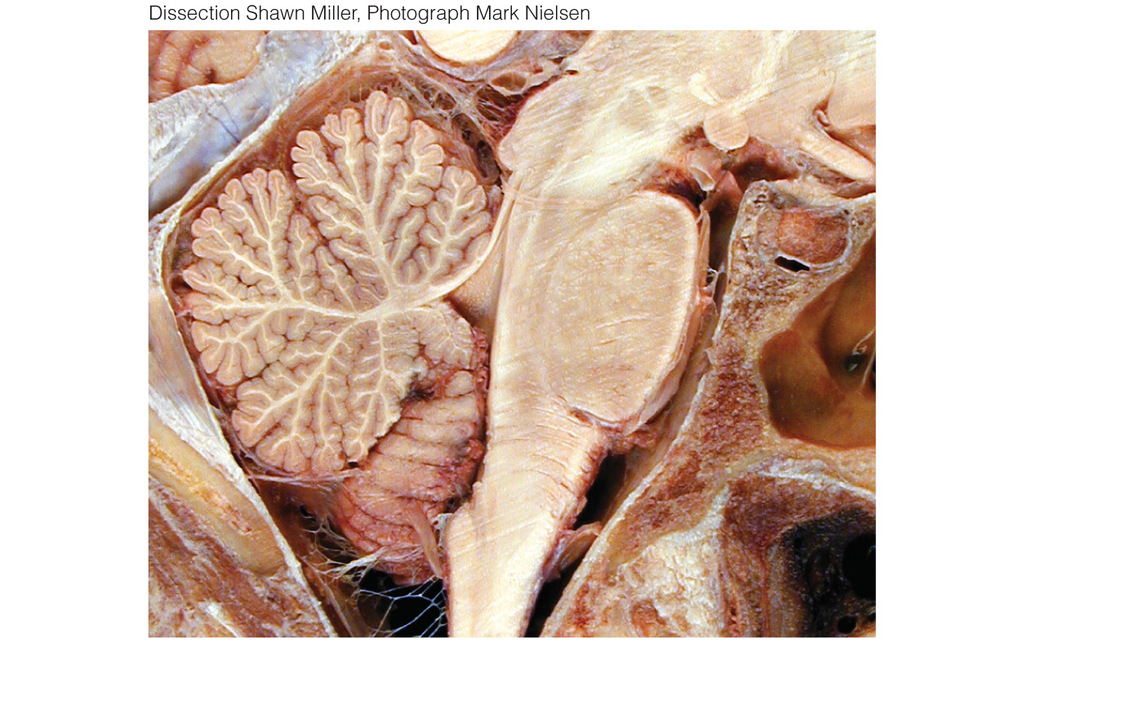
Cerebral peduncle
4
5
Mammillary
body
8
6
Fourth ventricle
7
9
(b) Midsagittal section
Copyright © 2021 John Wiley & Sons, Inc. All rights reserved.

Slide 11
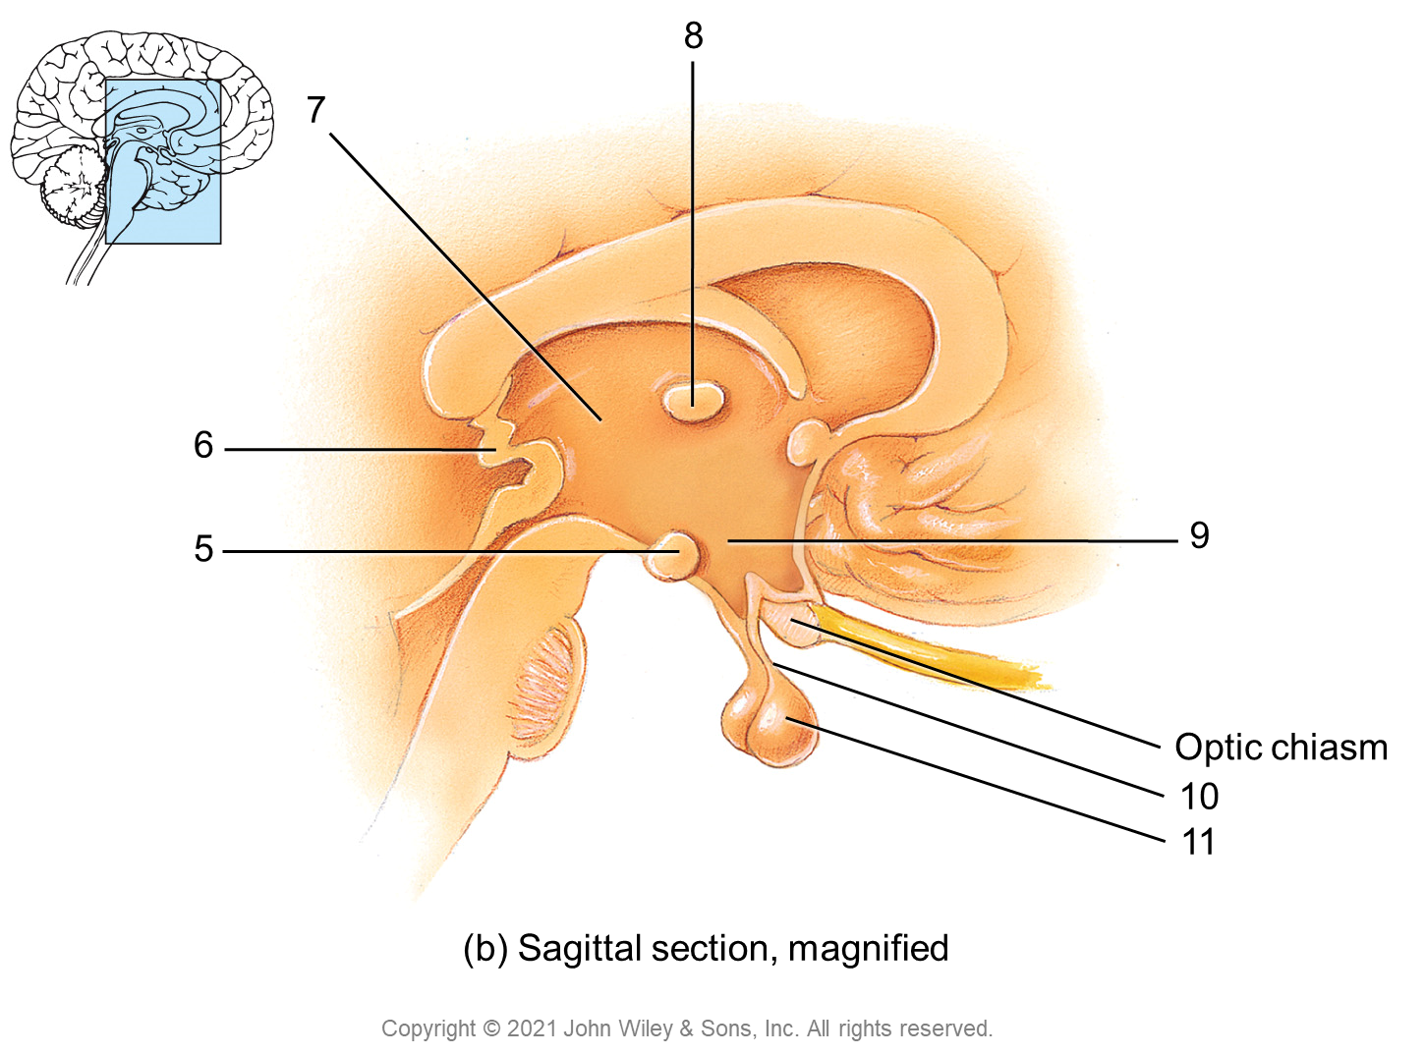
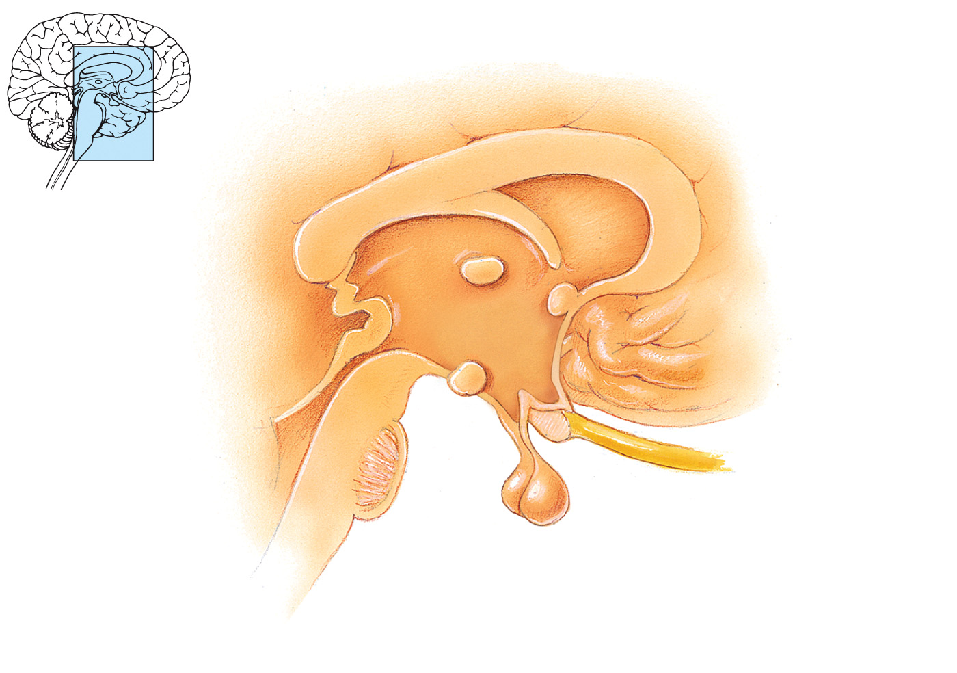
8
7
6
5
9
Optic chiasm
10
11
(b) Sagittal section, magnified
Copyright © 2021 John Wiley & Sons, Inc. All rights reserved.

Slide 12
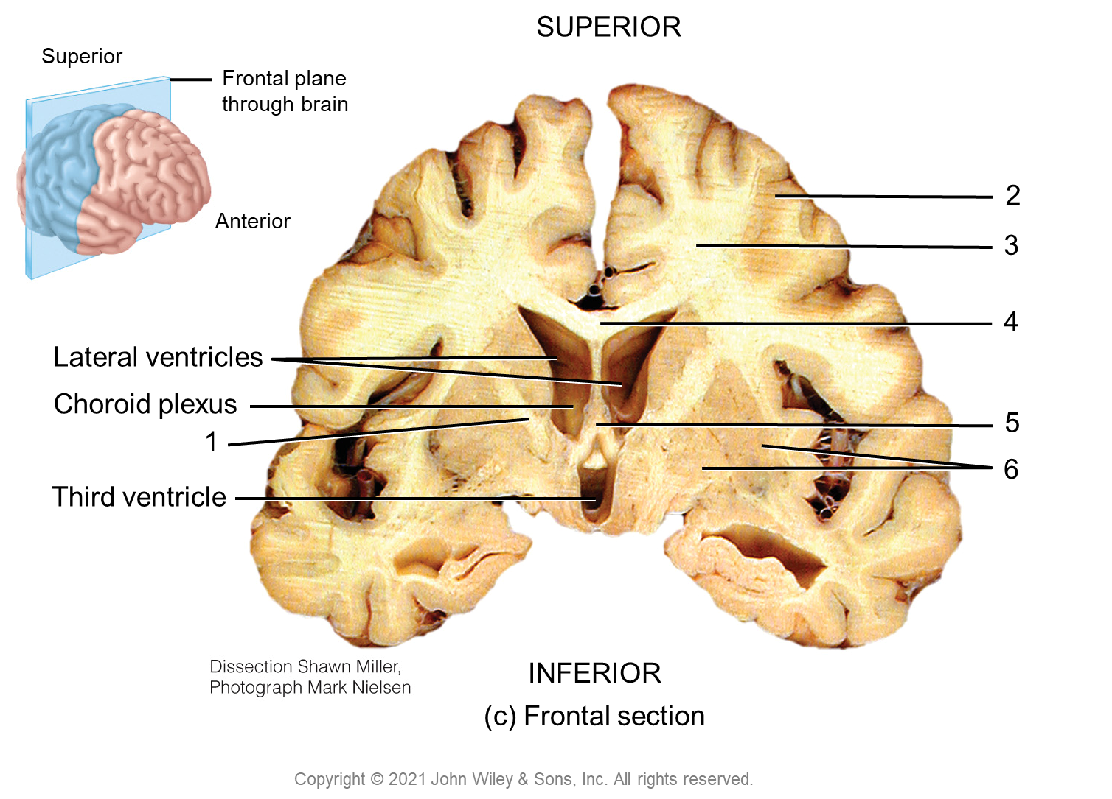
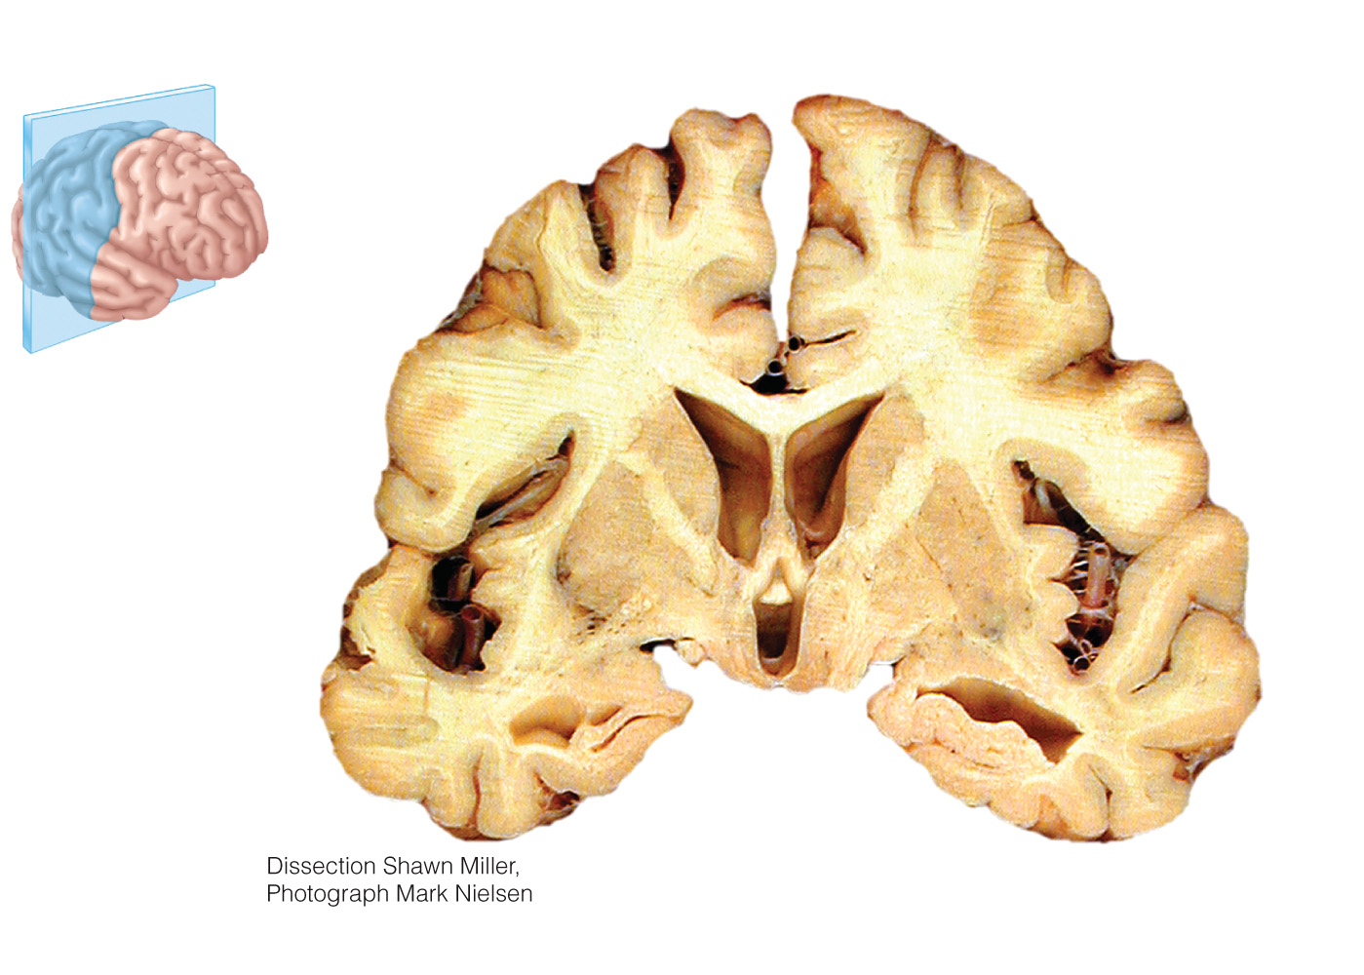
SUPERIOR
Superior
Frontal plane
through brain
2
Anterior
3
4
Lateral ventricles
Choroid plexus
5
1
6
Third ventricle
INFERIOR
(c) Frontal section
Copyright © 2021 John Wiley & Sons, Inc. All rights reserved.

Slide 13
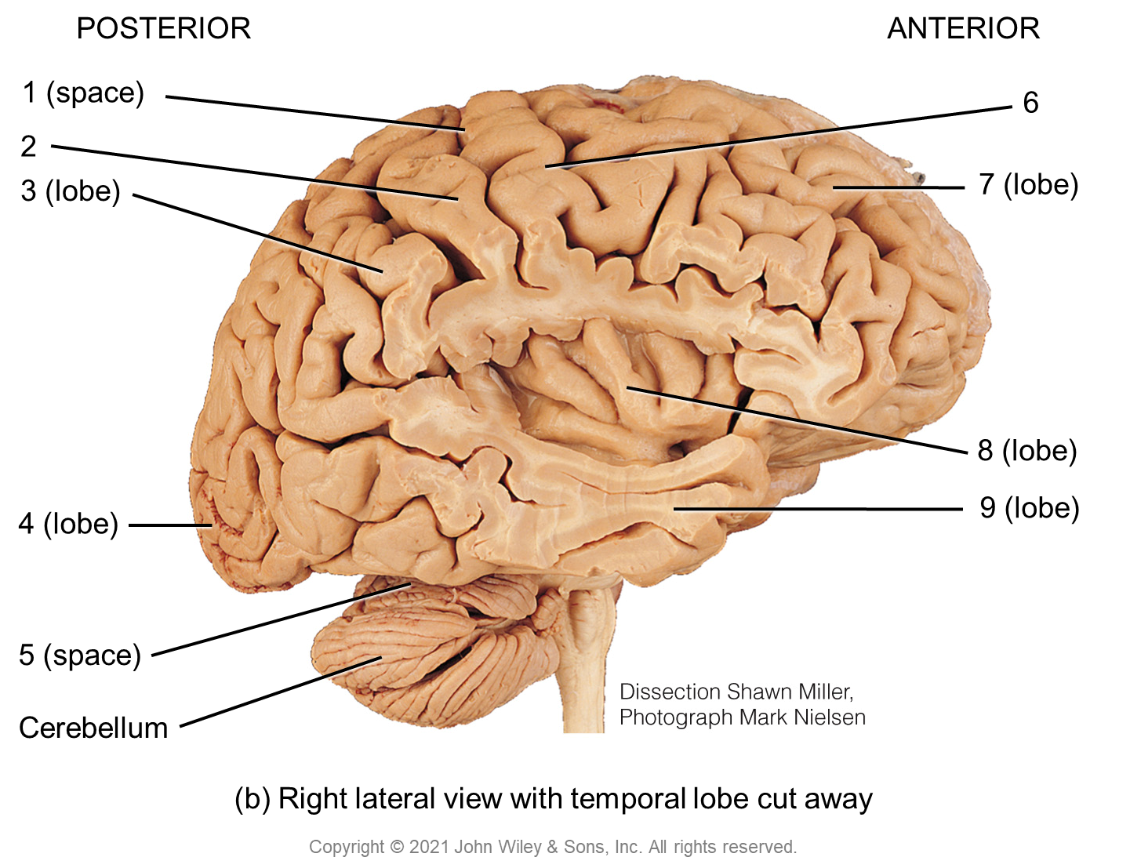
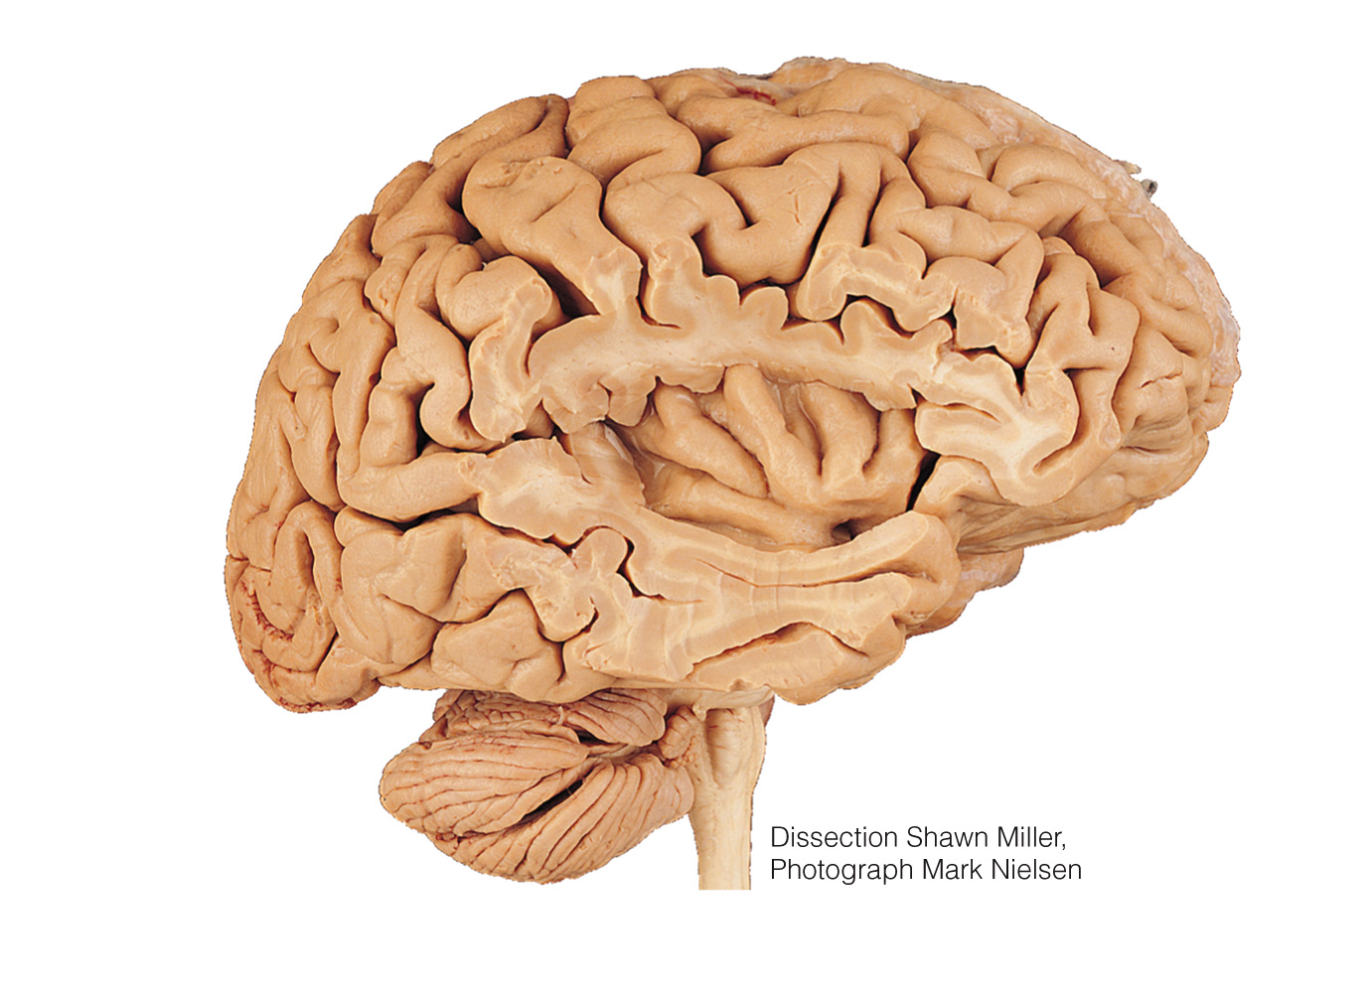
POSTERIOR
ANTERIOR
1 (space)
6
2
3 (lobe)
7 (lobe)
8 (lobe)
4 (lobe)
9 (lobe)
5 (space)
Cerebellum
(b) Right lateral view with temporal lobe cut away
Copyright © 2021 John Wiley & Sons, Inc. All rights reserved.

Slide 14
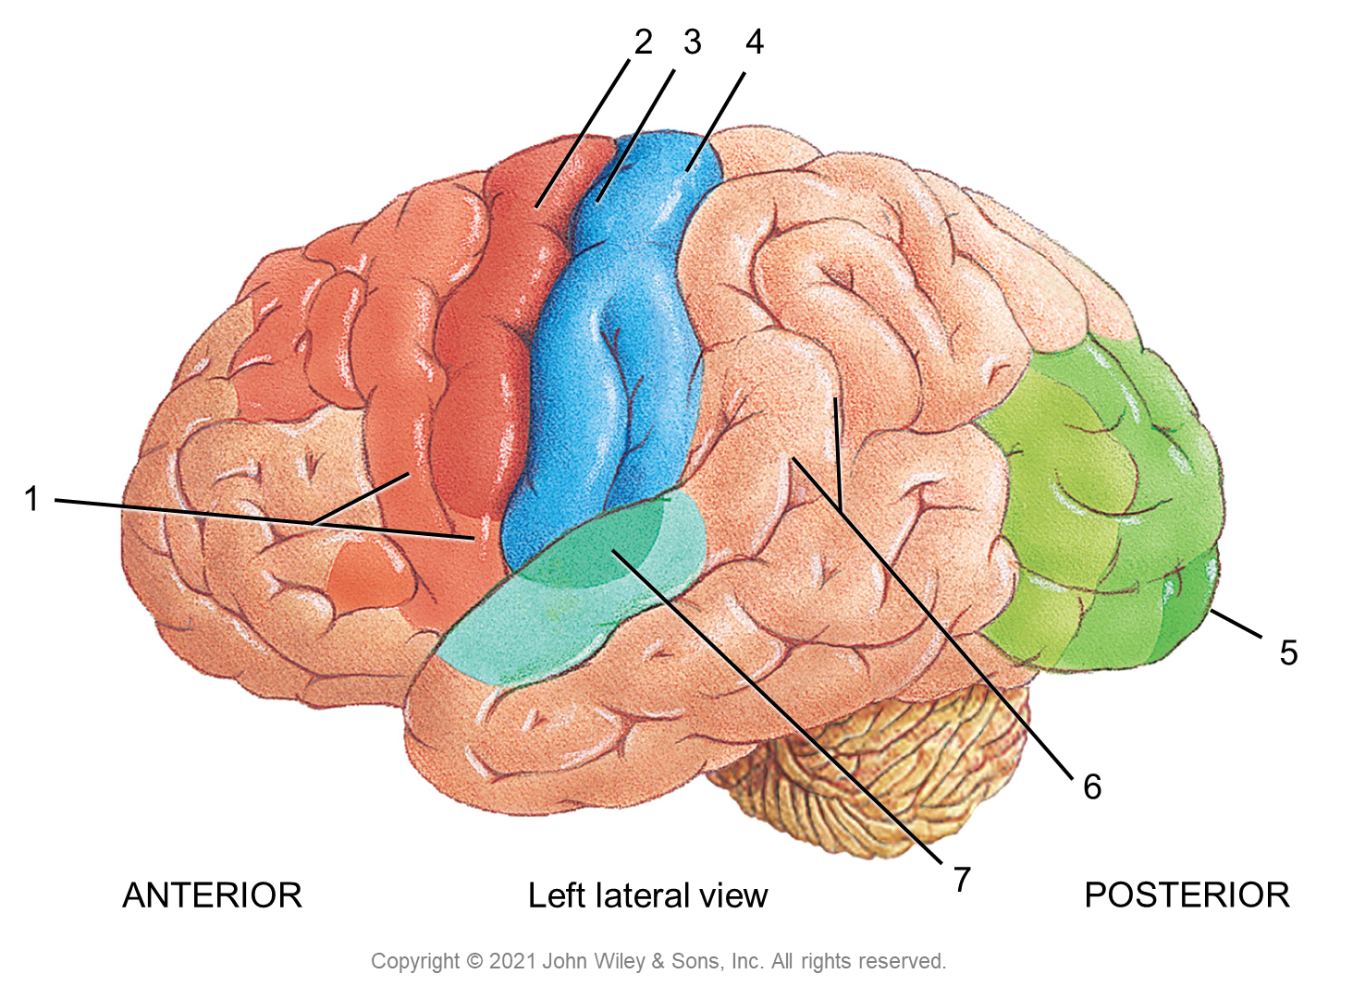

Slide 15
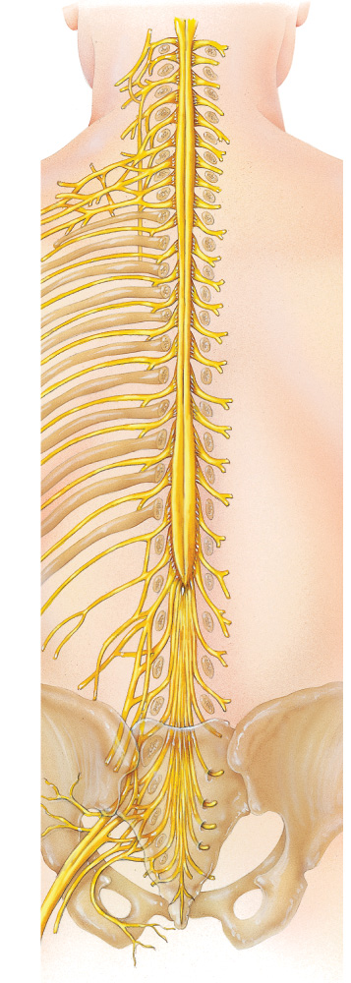
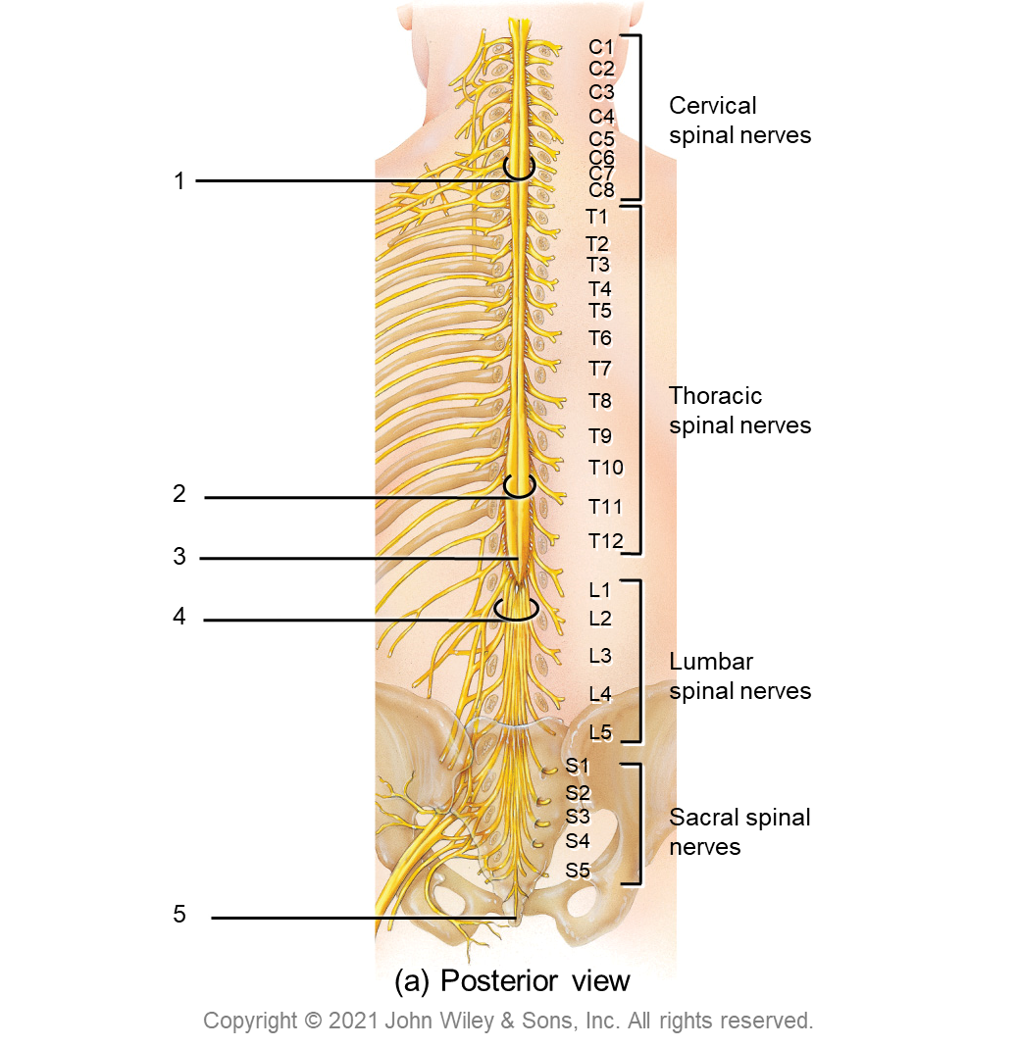
C1
C2
C3
Cervical spinal nerves
C4
C5
C6
1
C7
C8
T1
T2
T3
T4
T5
T6
T7
T8
Thoracic spinal nerves
T9
T10
2
T11
3
T12
L1
4
L2
L3
Lumbar spinal nerves
L4
L5
S1
S2
Sacral spinal nerves
S3
S4
S5
5
(a) Posterior view
Copyright © 2021 John Wiley & Sons, Inc. All rights reserved.

Slide 16
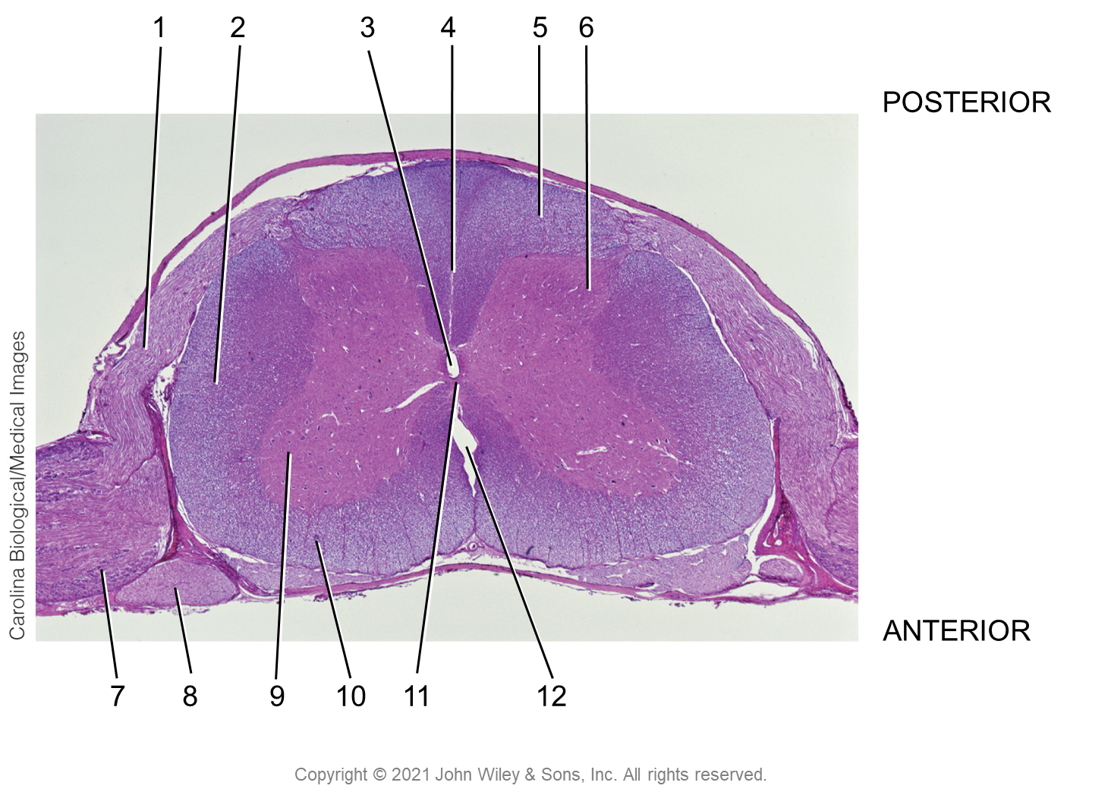
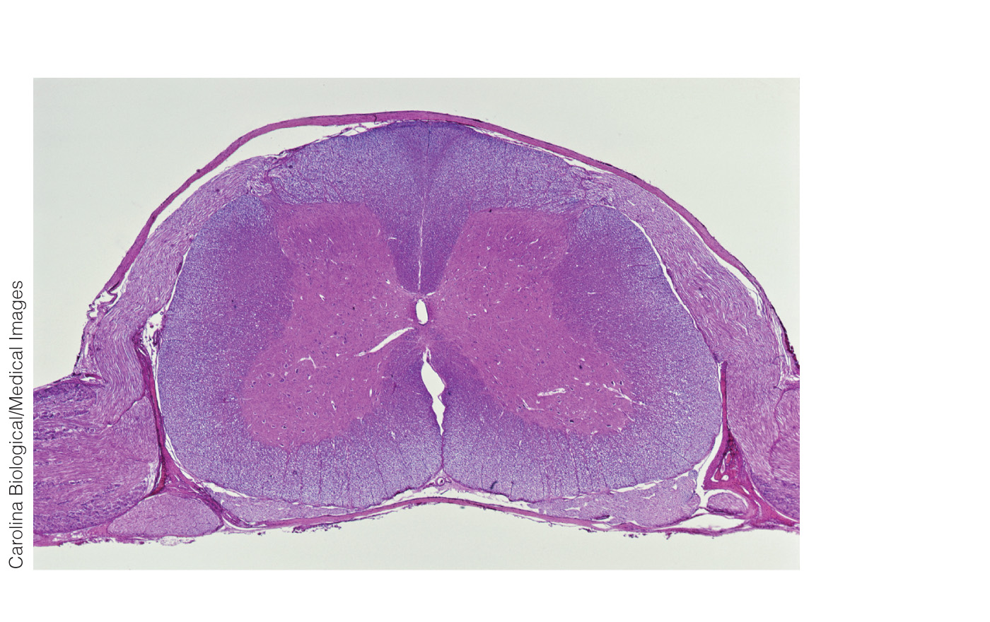
1
2
3
4
5
6
POSTERIOR
ANTERIOR
7
8
9
10
11
12
Copyright © 2021 John Wiley & Sons, Inc. All rights reserved.

Slide 17
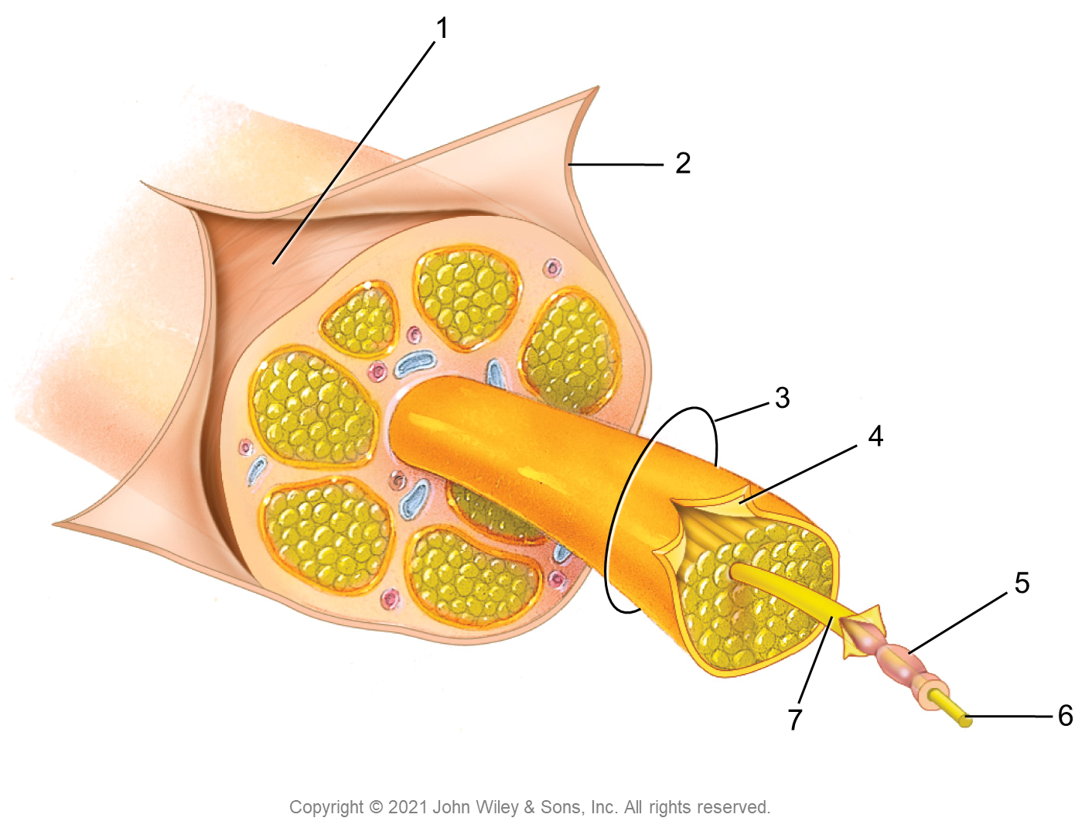
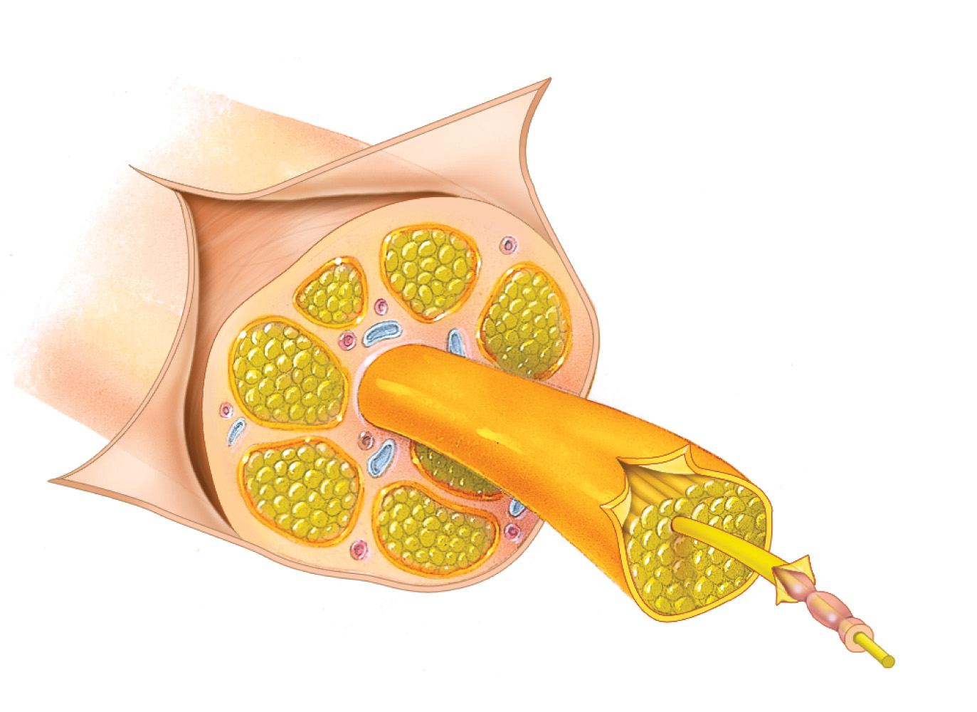
1
2
3
4
5
7
6
Copyright © 2021 John Wiley & Sons, Inc. All rights reserved.

Slide 18
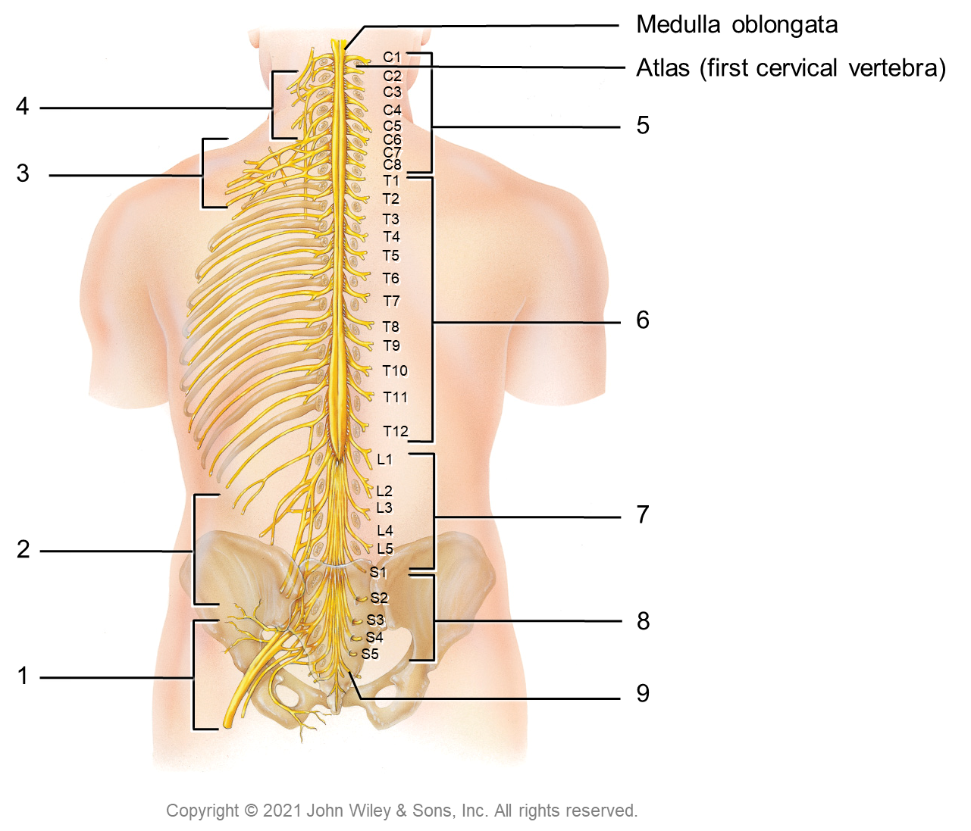
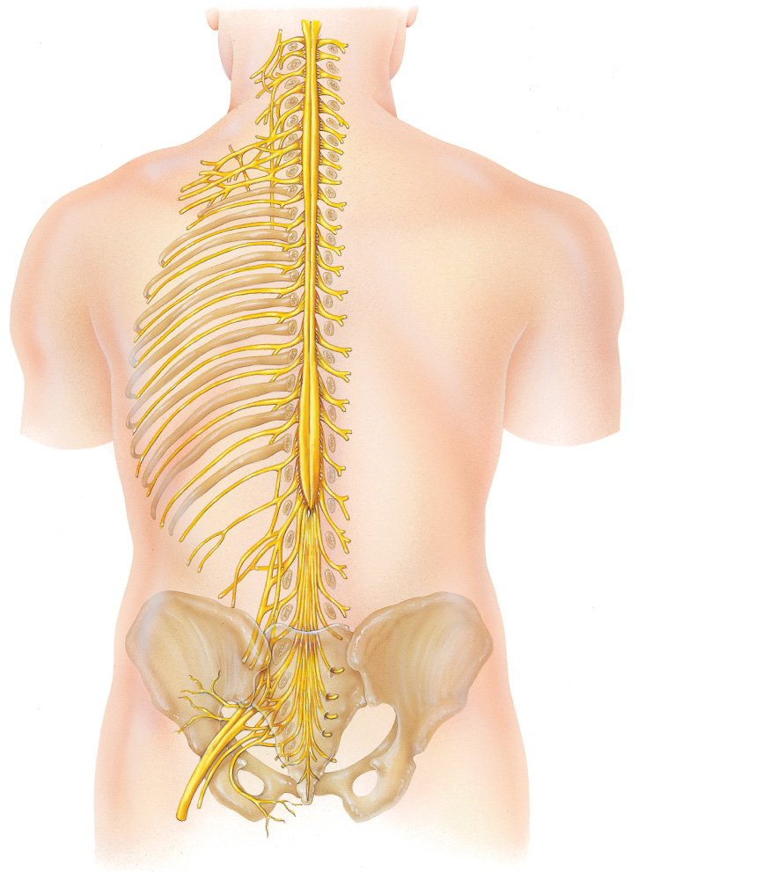
Medulla oblongata
C1
Atlas (first cervical vertebra)
C2
4
C3
C4
5
C5
C6
C7
3
C8
T1
T2
T3
T4
T5
T6
T7
6
T8
T9
T10
T11
T12
L1
L2
7
L3
2
L4
L5
S1
S2
8
S3
S4
1
S5
9
Copyright © 2021 John Wiley & Sons, Inc. All rights reserved.

Slide 19
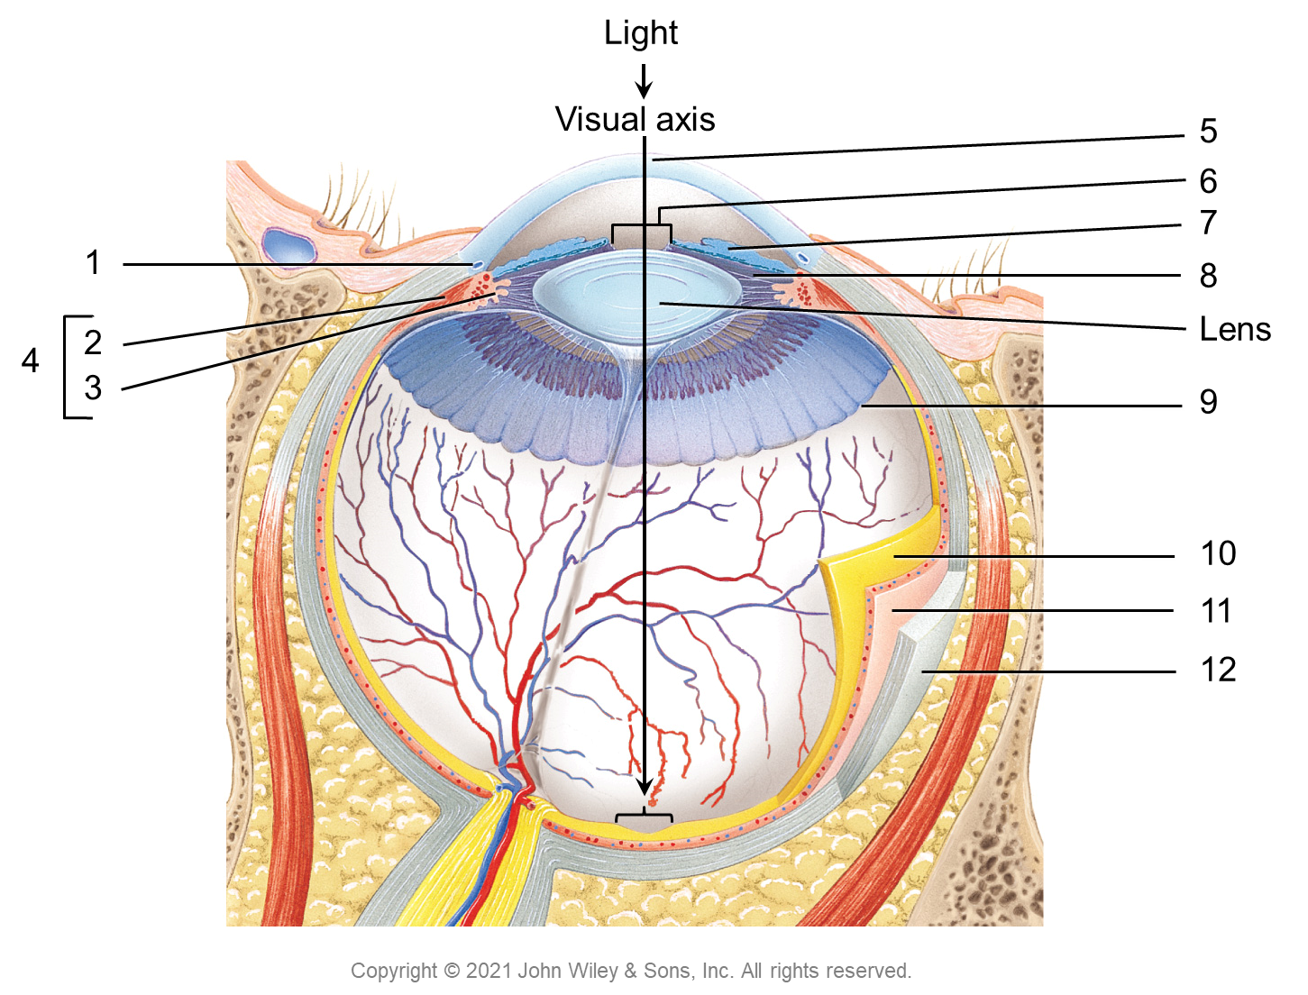
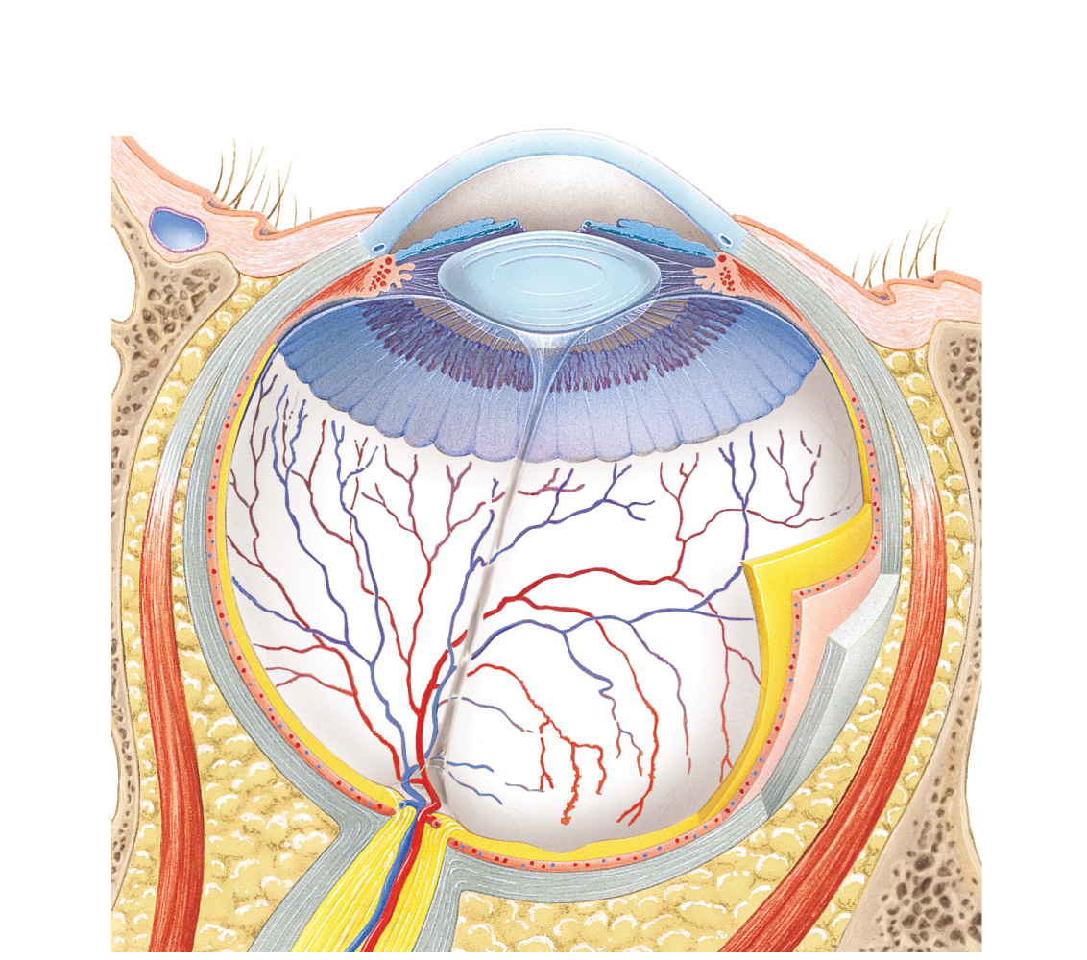
Light
Visual axis
5
6
7
1
8
2
Lens
4
3
9
10
11
12
Copyright © 2021 John Wiley & Sons, Inc. All rights reserved.

Slide 20
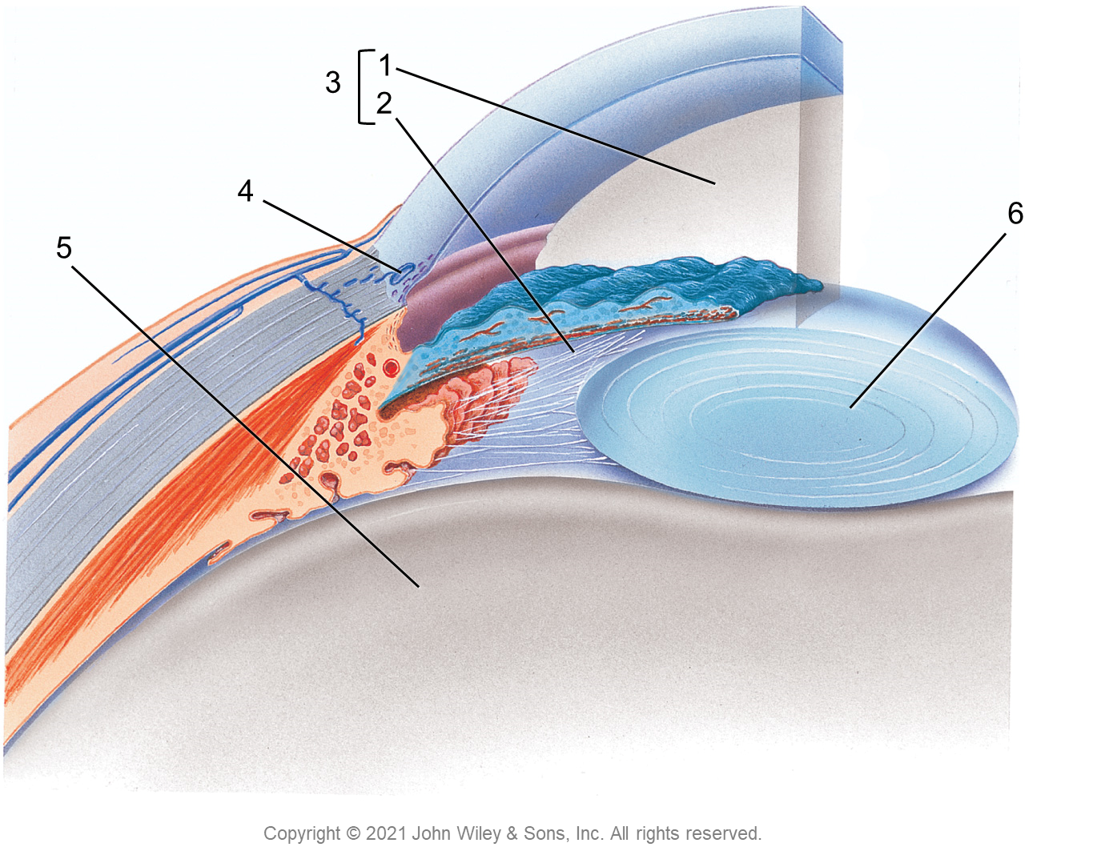
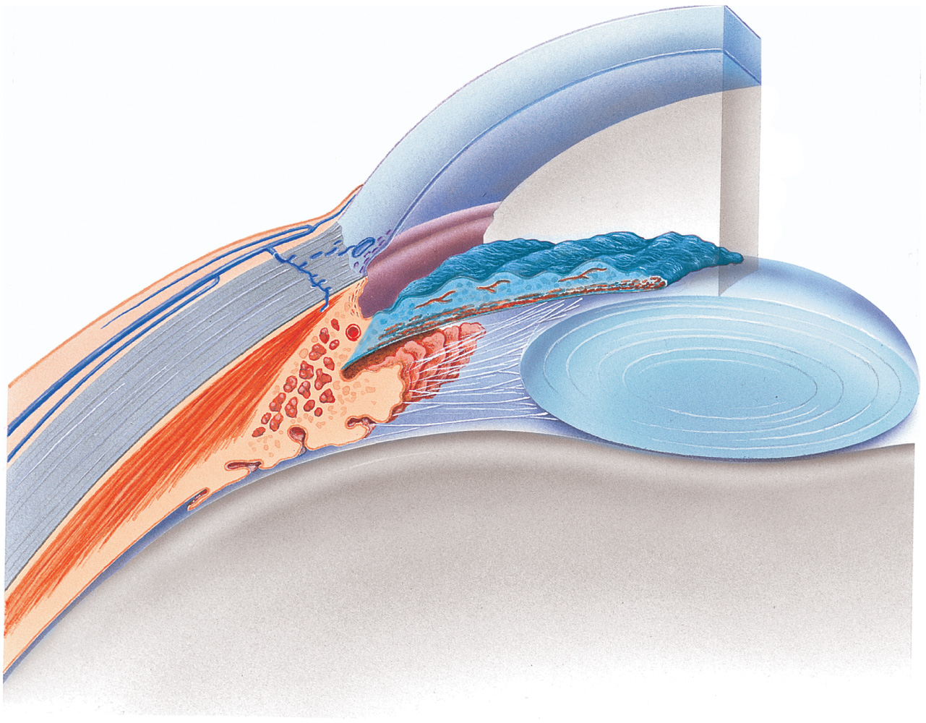
3
1
2
4
6
5
Copyright © 2021 John Wiley & Sons, Inc. All rights reserved.

Slide 21
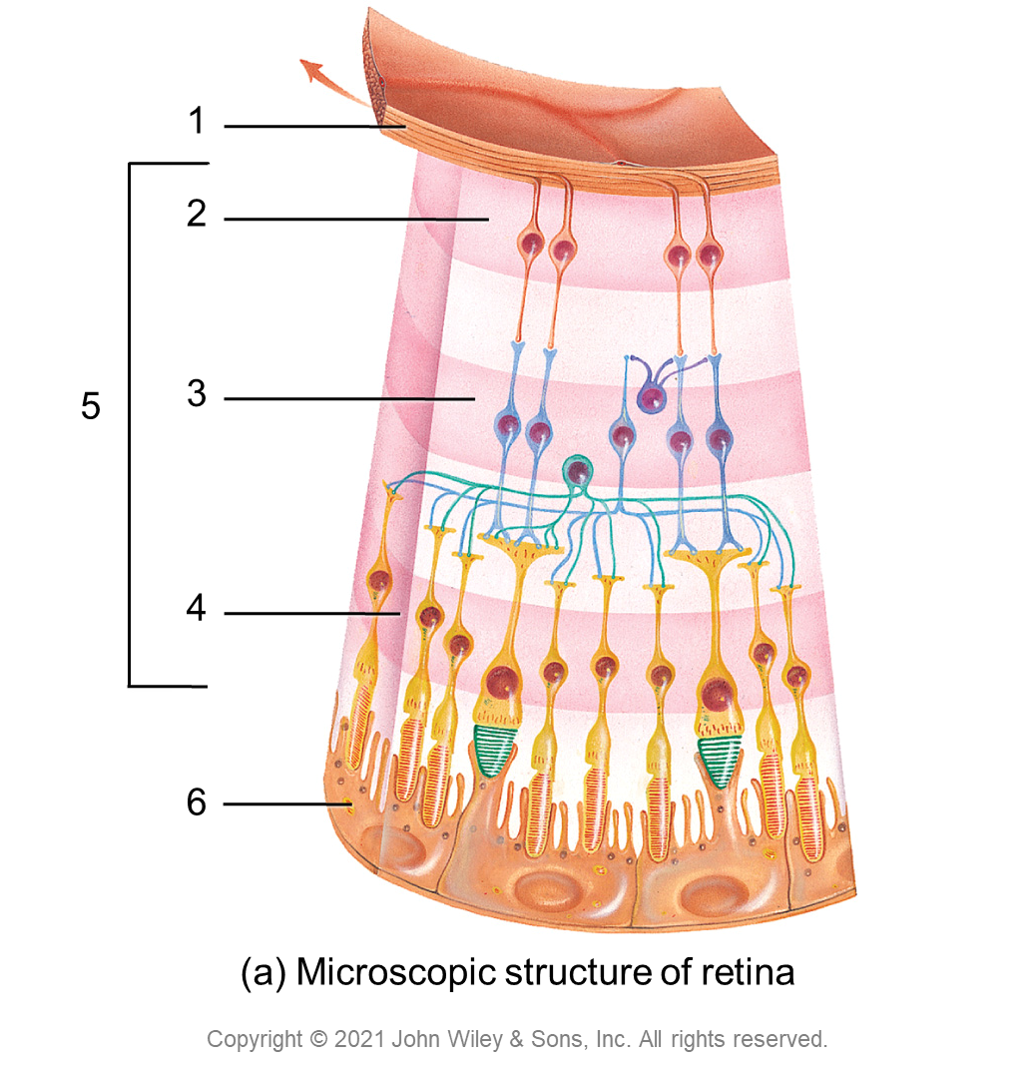
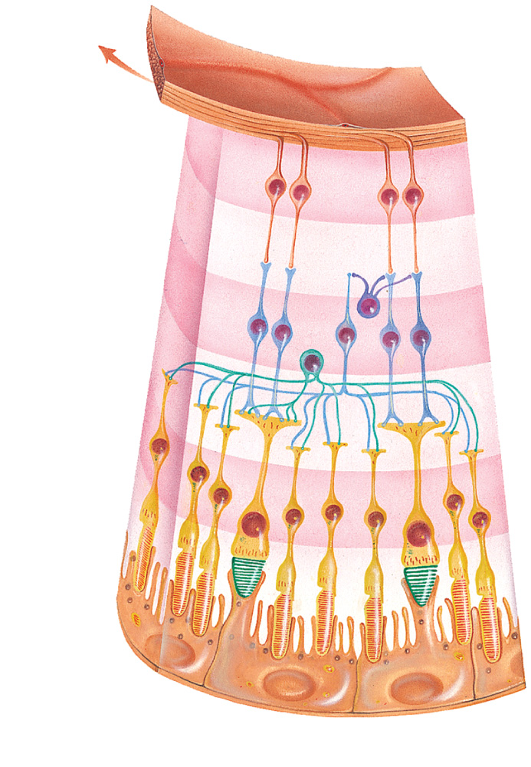
1
2
5
3
4
6
(a) Microscopic structure of retina
Copyright © 2021 John Wiley & Sons, Inc. All rights reserved.

Slide 22
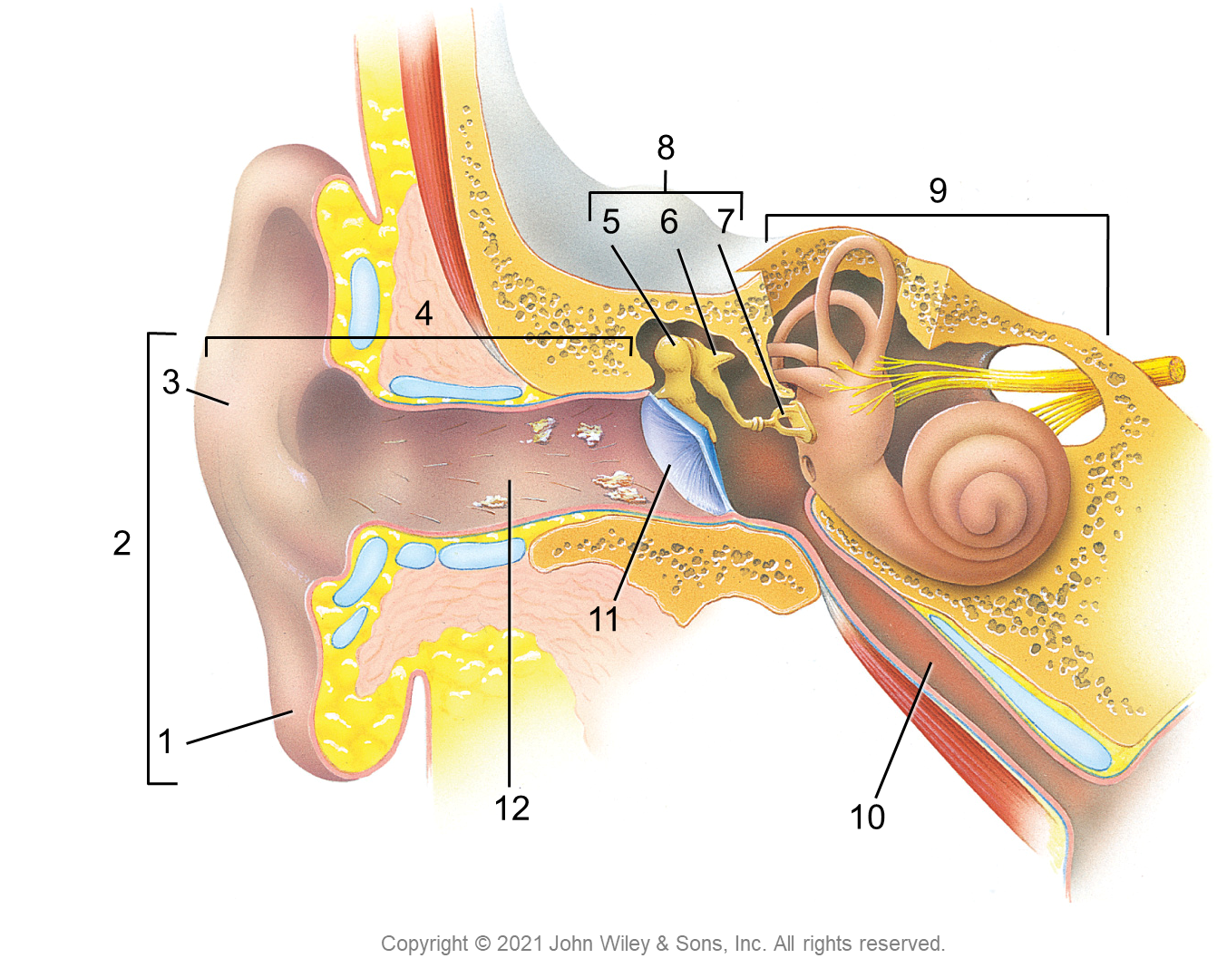
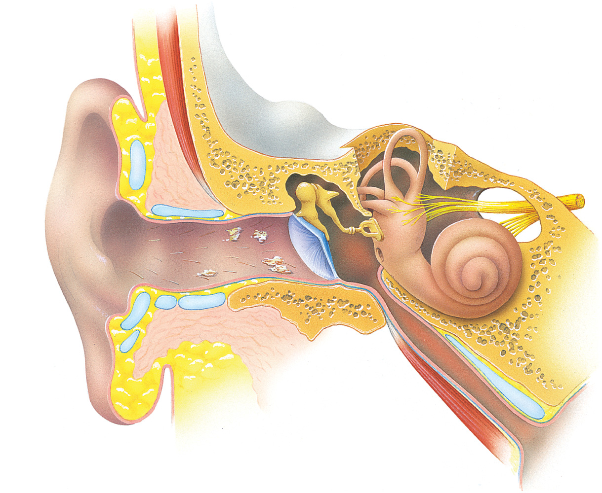
8
9
5
6
7
4
3
2
11
1
12
10
Copyright © 2021 John Wiley & Sons, Inc. All rights reserved.

Slide 23
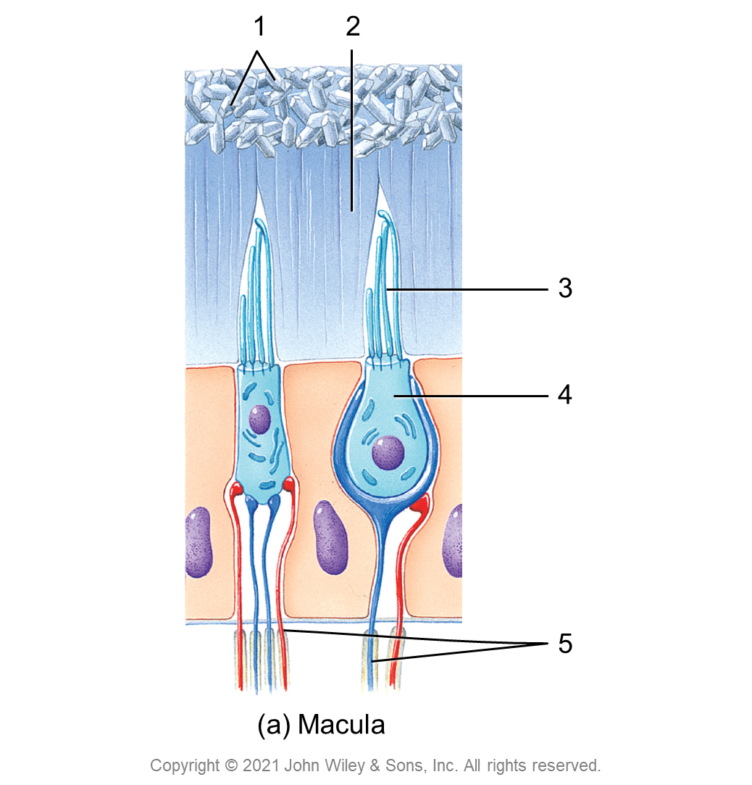
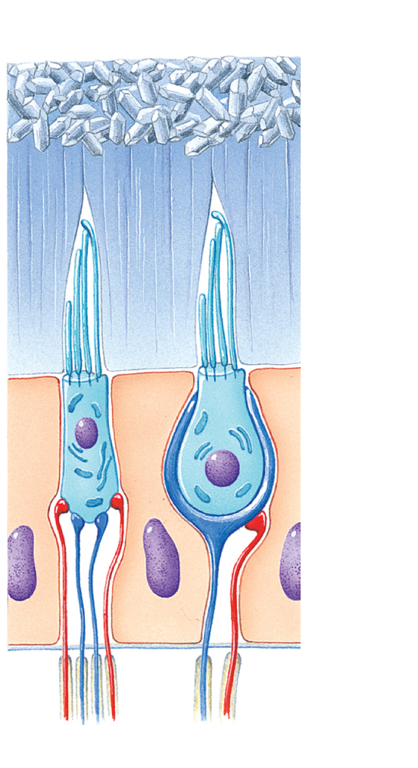
1
2
3
4
5
(a) Macula
Copyright © 2021 John Wiley & Sons, Inc. All rights reserved.

Slide 24
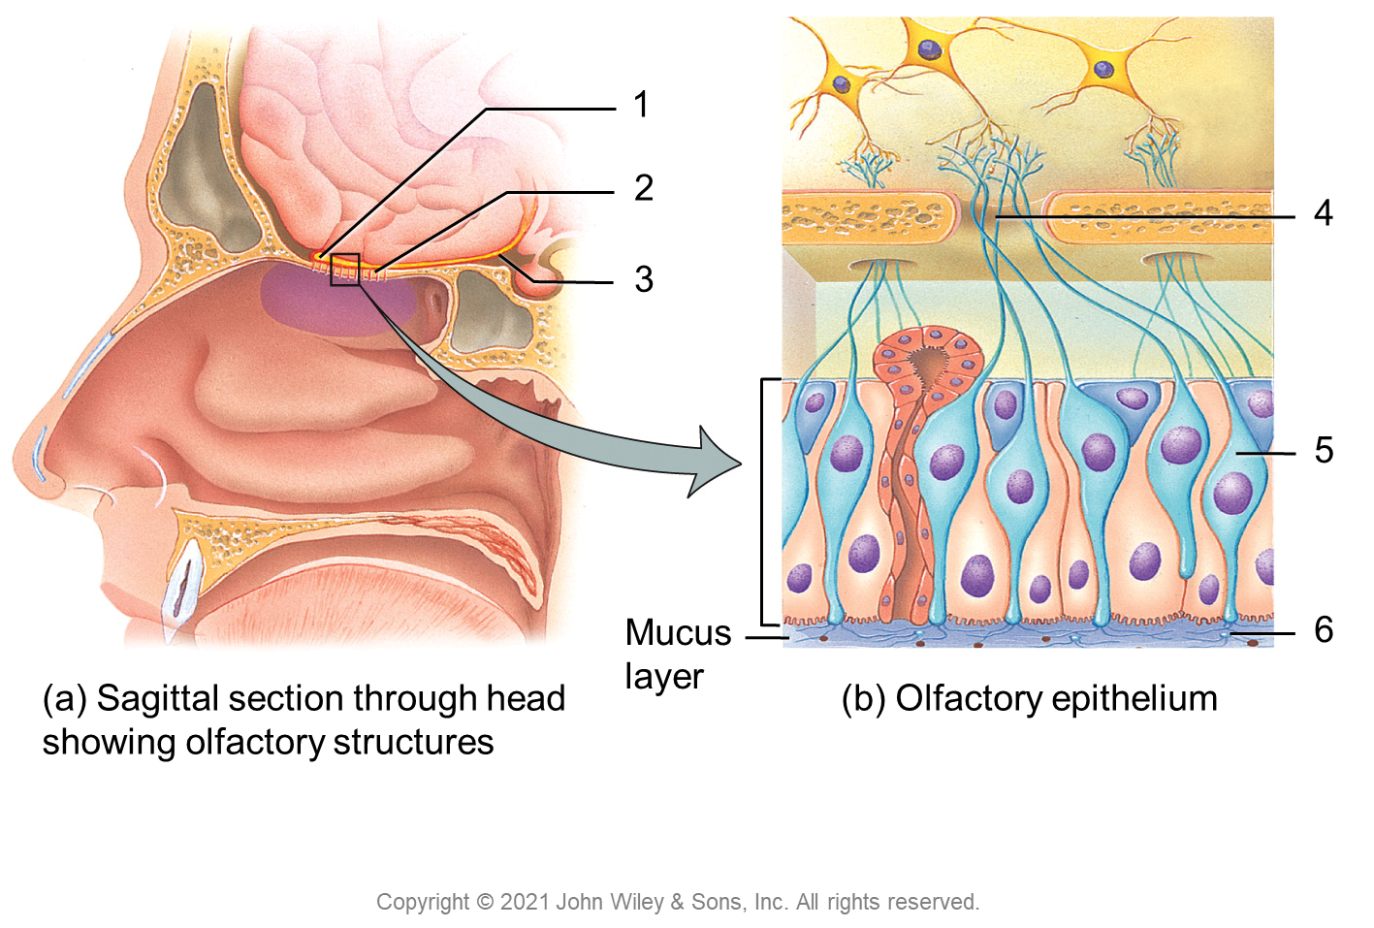
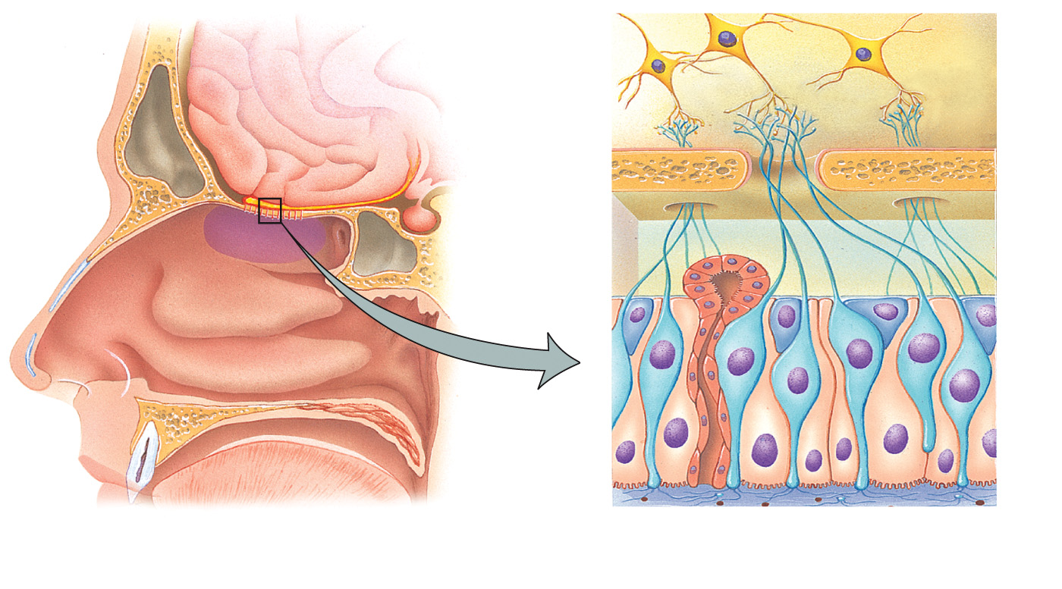
1
2
4
3
5
Mucus
layer
6
(a) Sagittal section through head
showing olfactory structures
(b) Olfactory epithelium
Copyright © 2021 John Wiley & Sons, Inc. All rights reserved.

Slide 25
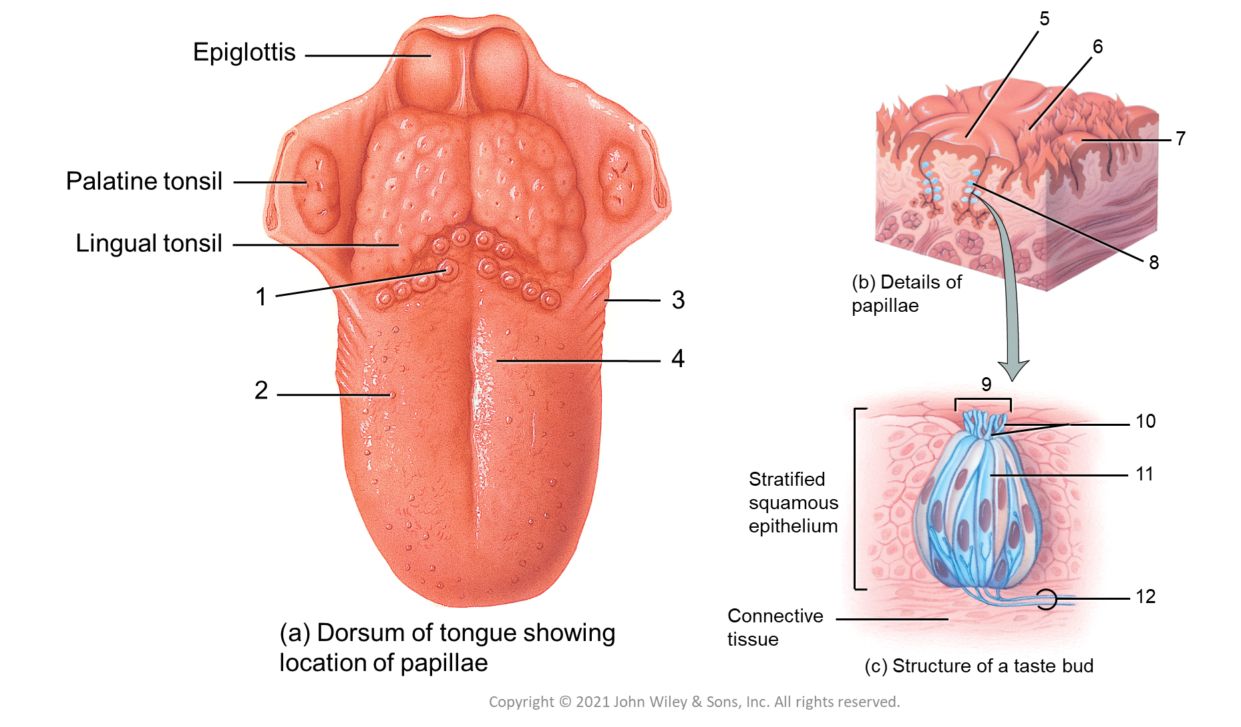
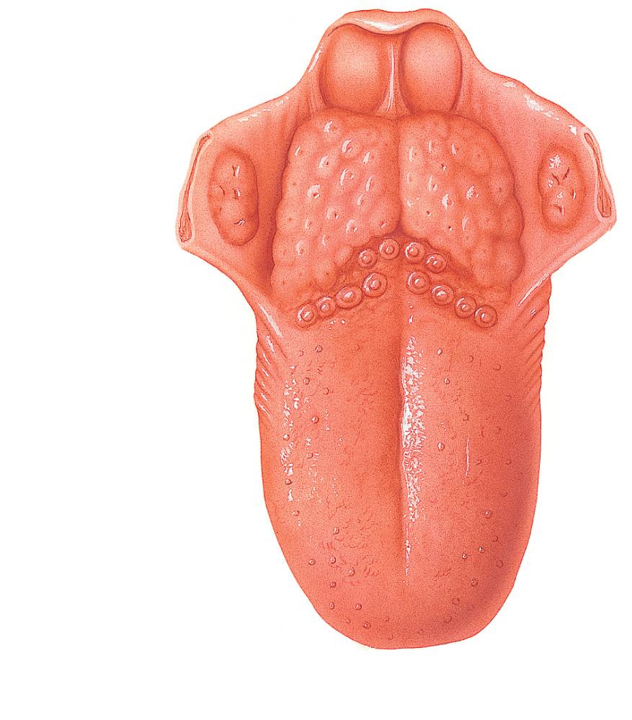
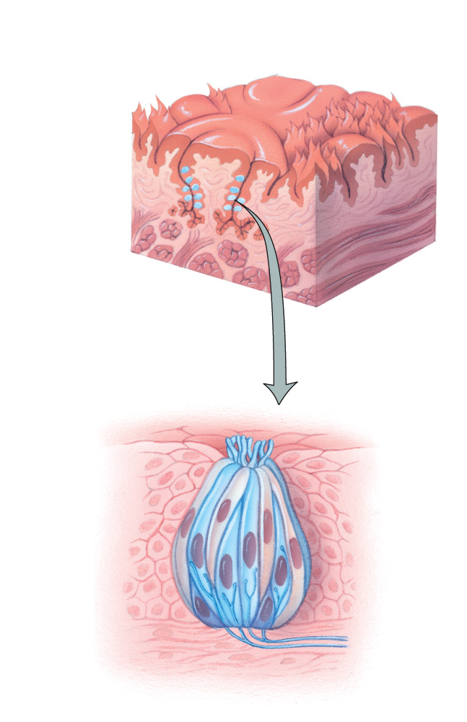
5
Epiglottis
6
7
Palatine tonsil
Lingual tonsil
8
1
3
(b) Details of papillae
4
2
9
10
Stratified
squamous
epithelium
11
12
(a) Dorsum of tongue showing
location of papillae
Connective
tissue
(c) Structure of a taste bud
Copyright © 2021 John Wiley & Sons, Inc. All rights reserved.

